Slide 1
ACE Analytics for Course Engagement
Kaylene Sampson, Programme Director, Student Success
Ellie Kay , ACE Project Lead.

Slide 2
What is ACE?
Student-facing dashboard
Teacher resources
Re-engagement programme

Slide 3
Enhancing self-direction and engagement

Slide 4
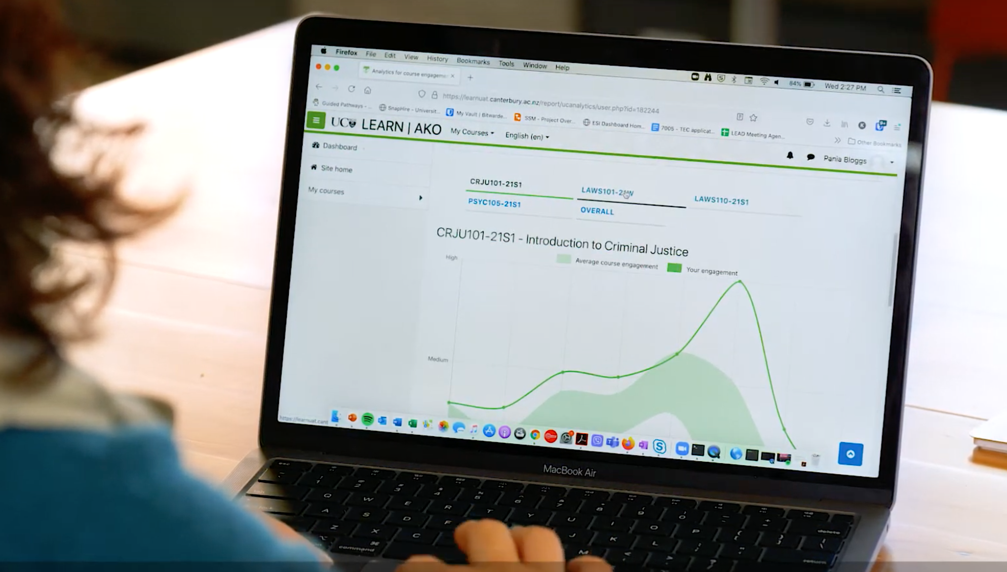
“It’s been phenomenal and very easy to adjust time on certain courses depending on how it fluctuates...”
Notes:
T

Slide 5
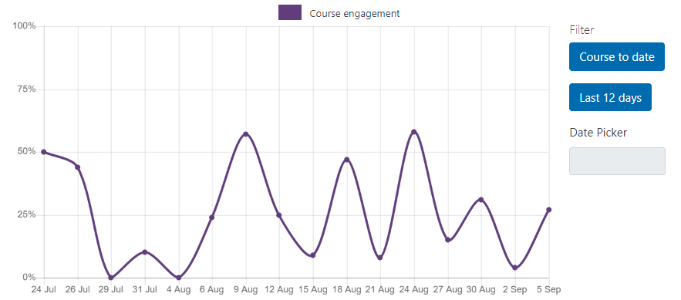
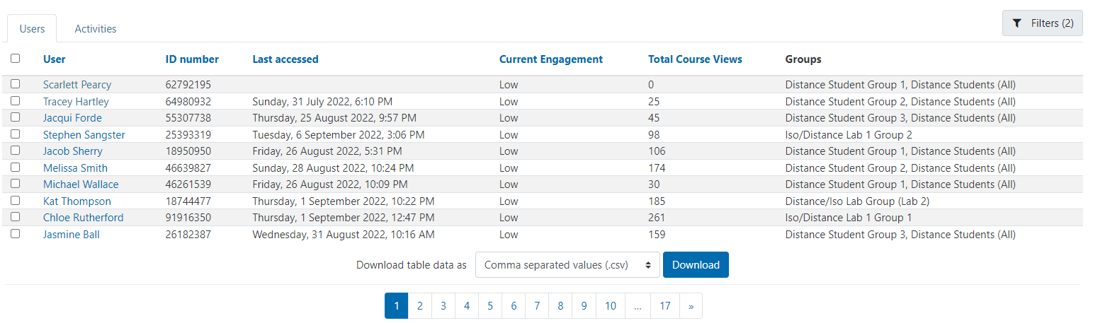
Teachers understanding engagement
Names removed
IDs
removed

Slide 6
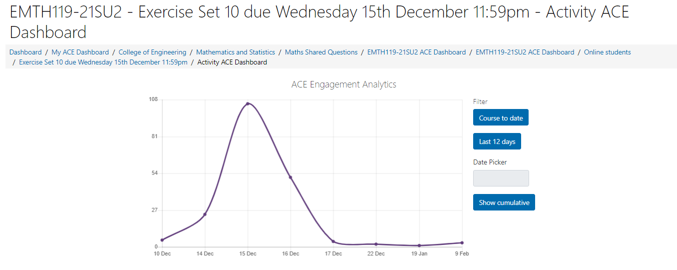
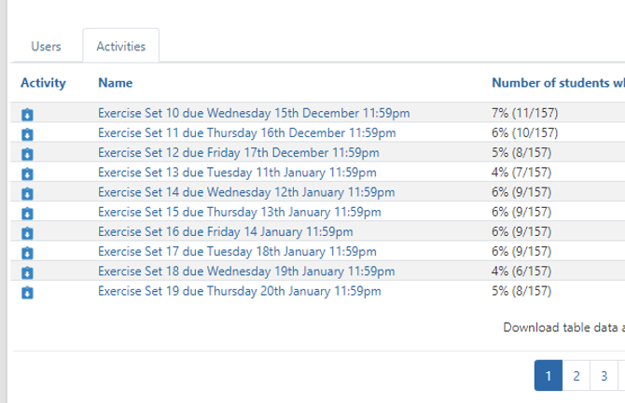
Engagement with individual activities

Slide 7
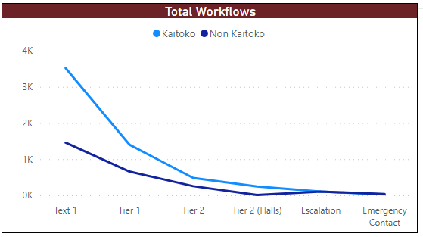
Proactive re-engagement programme
Semester 1 2022
1st year
2nd year and above
ACE Text and Email
Academic Advisory
Student care
Student emergency

Slide 8
Impacts of ACE text intervention
33%
35%
46%
Increased engagement with Moodle
Clicks
Sustained engagement in Moodle
Time
Increased engagement with ACE dashboard
Time

Slide 9
Future Directions – ACE
Further refinement of students dashboards
Org wide campaign focusing on the best use of Moodle to sharpen engagement measurements.
Expand the functionality to support proactive outreach earlier in the student journey.

