Slide 1
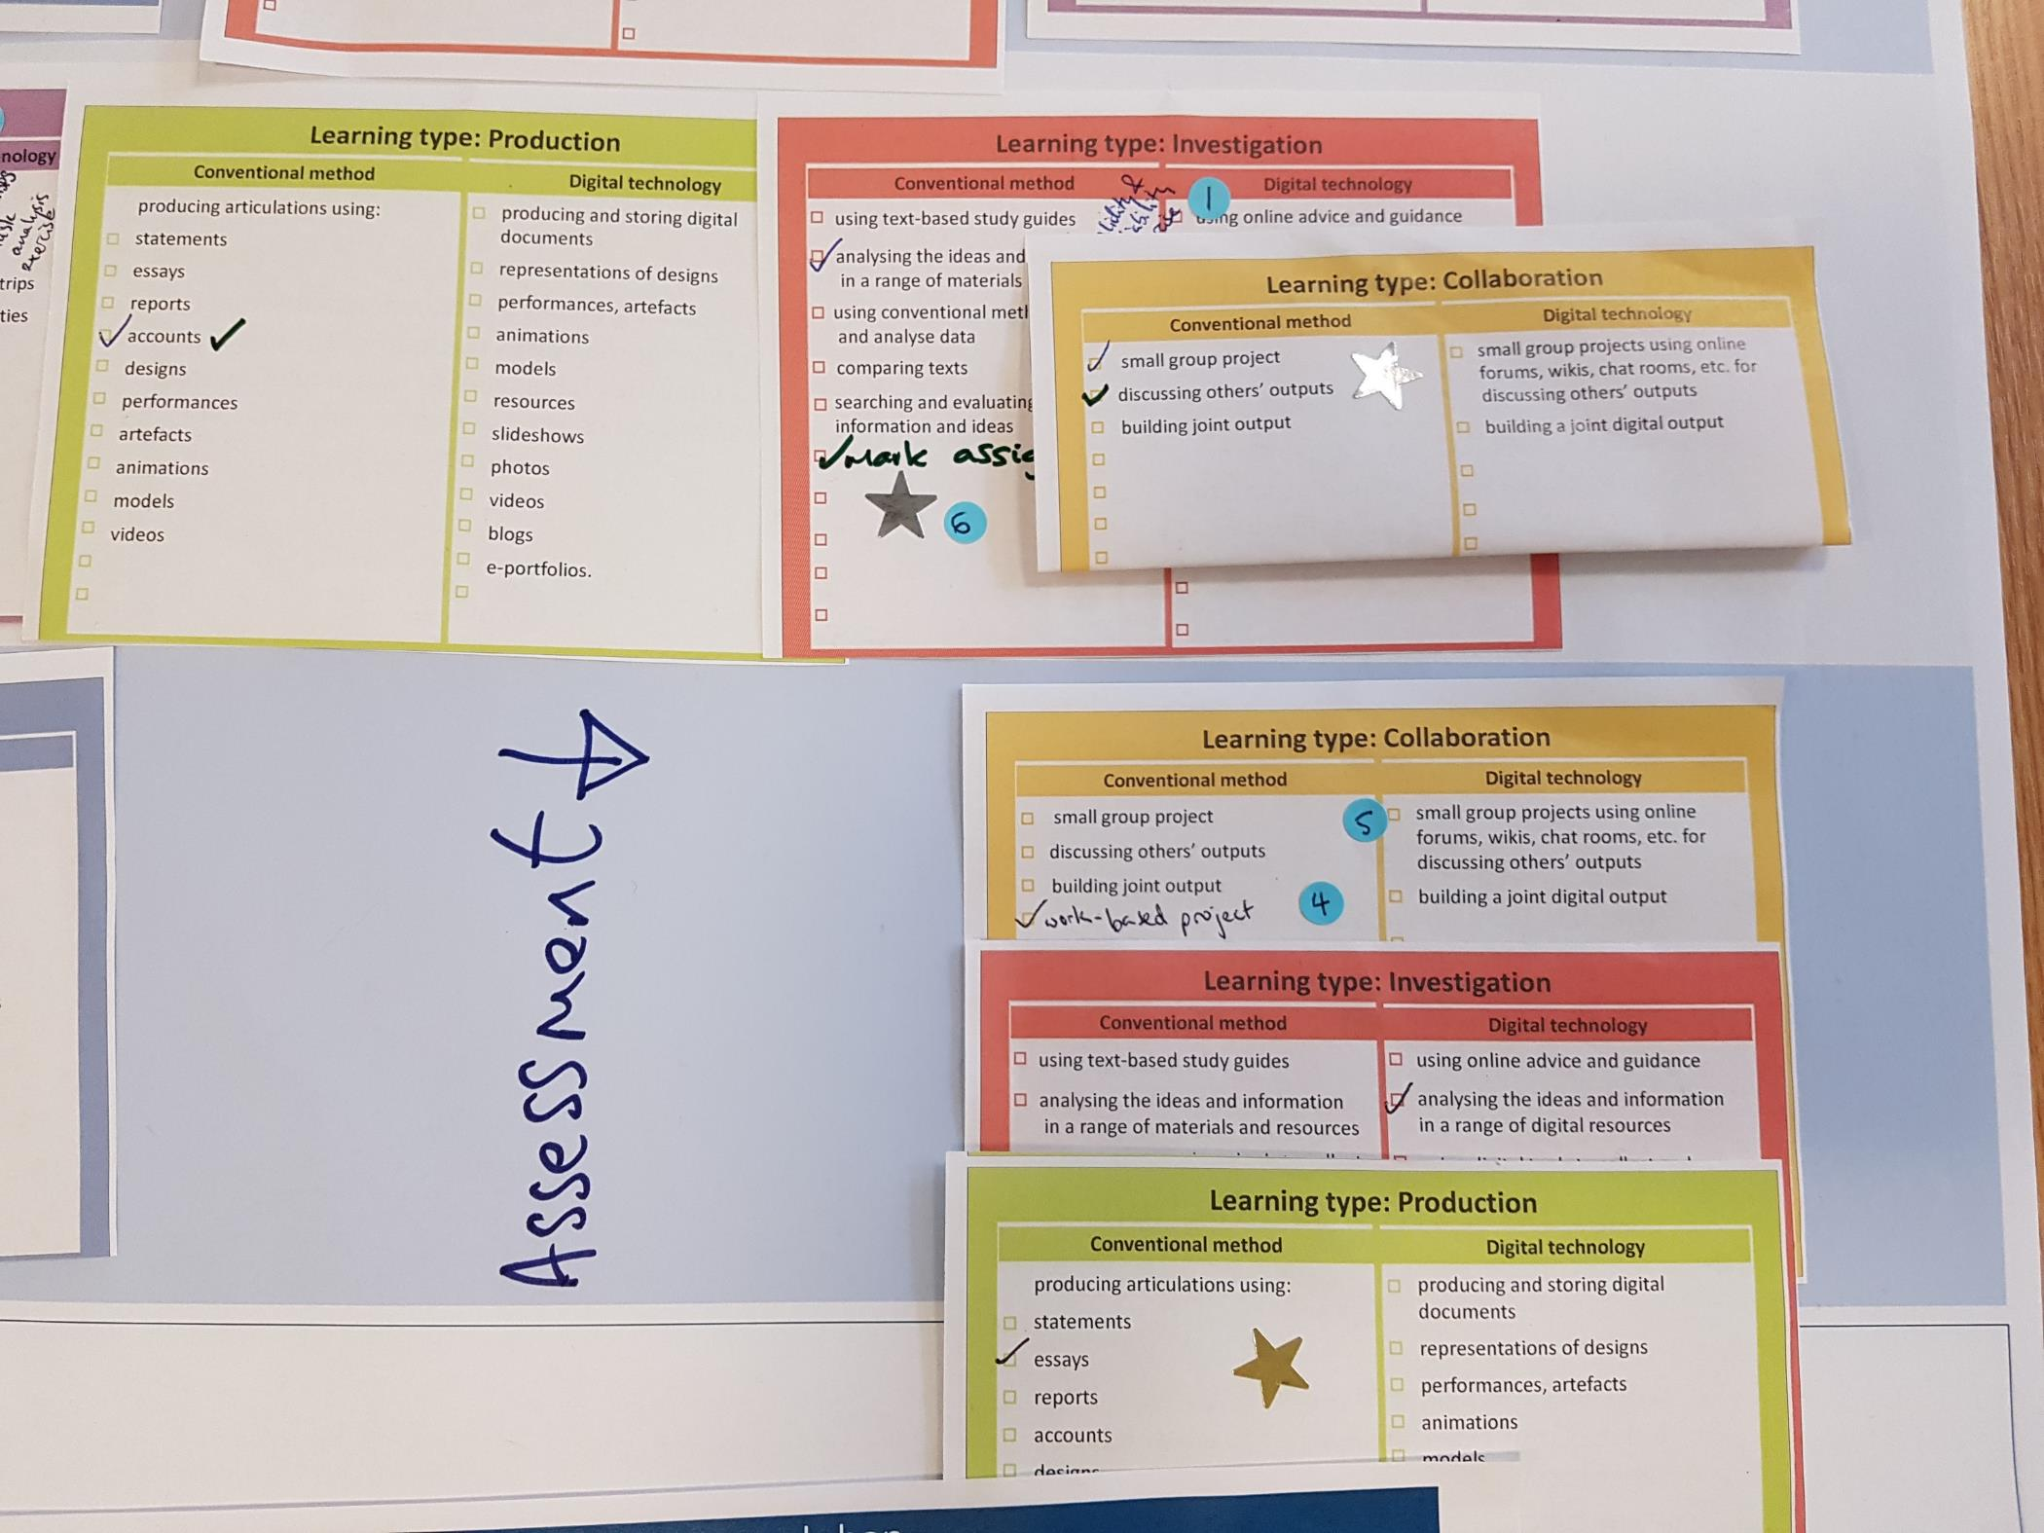
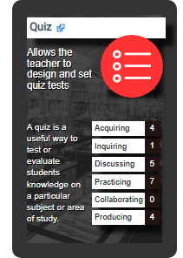
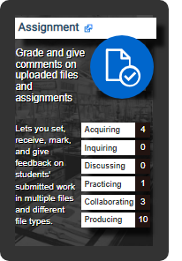
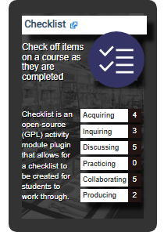
Aligning ABC Learning Design with Moodle: Introducing the APT methodology
Faculty of MATHEMATICAL & PHYSICAL SCIENCES
Dr Richard Osborne Faculty Learning Technology Lead, MAPS
Dr Clive Young
Head of Programme Development, Arena

Slide 2
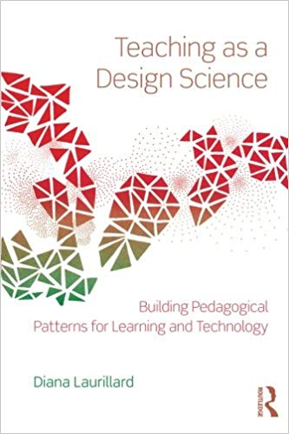
The ABC Learning Design method
ABC - High-energy collaborative academic engagement workshop used with 1000+ UCL teachers since 2015
fast
student centred
activity-based design
conversational
creative
discipline-neutral
consensus – shared vision
narrative – storyboard
modules, MOOCs, short courses
based on theory

Slide 3
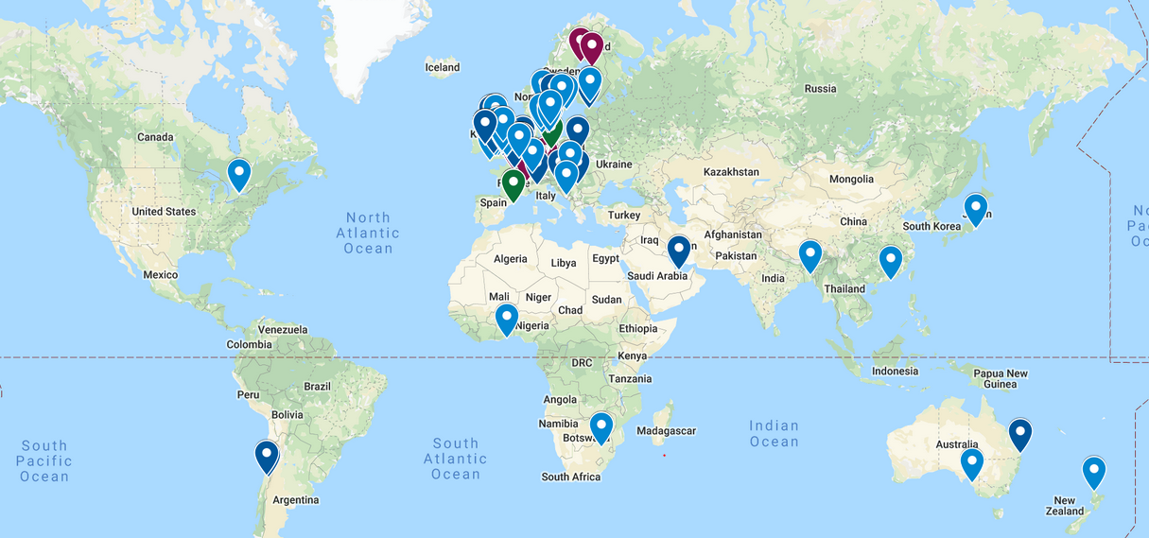
The ABC international community: A global phenomenon!

Slide 4
Conversational Framework / 6 Learning Types

Slide 5
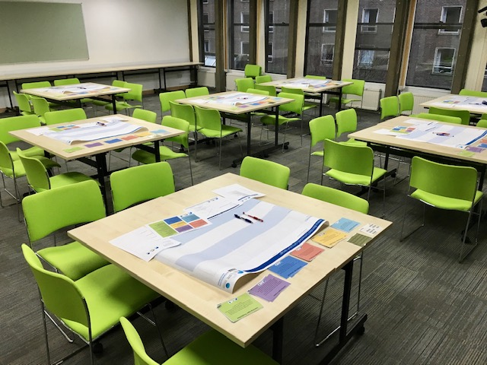
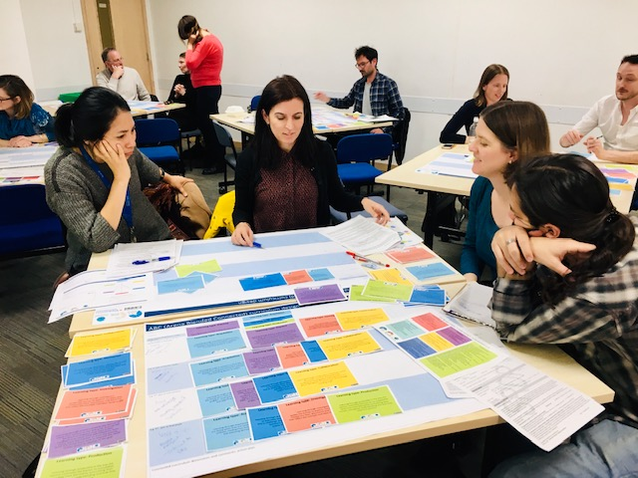
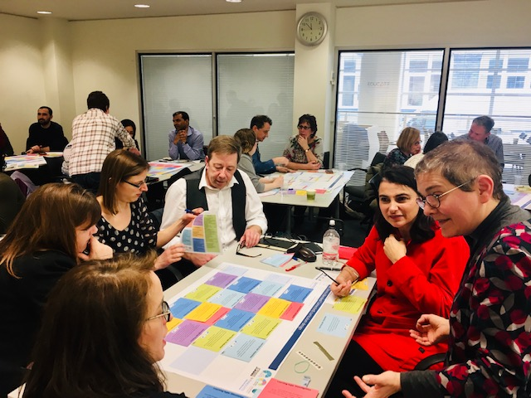
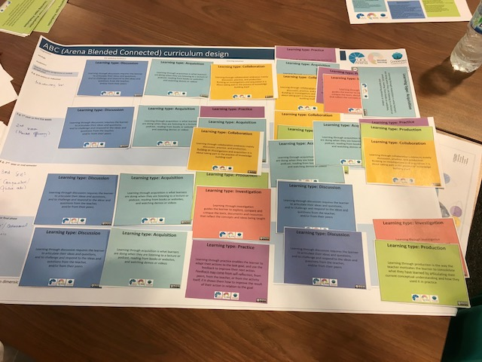
How does ABC work?

Slide 6
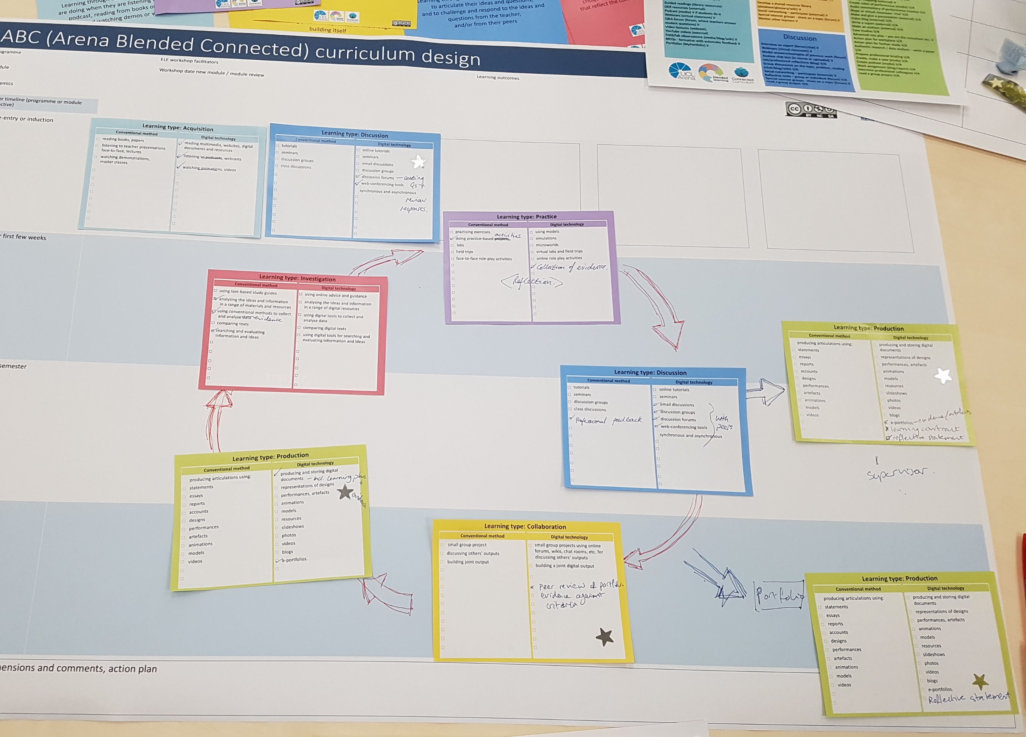
End product

Slide 7
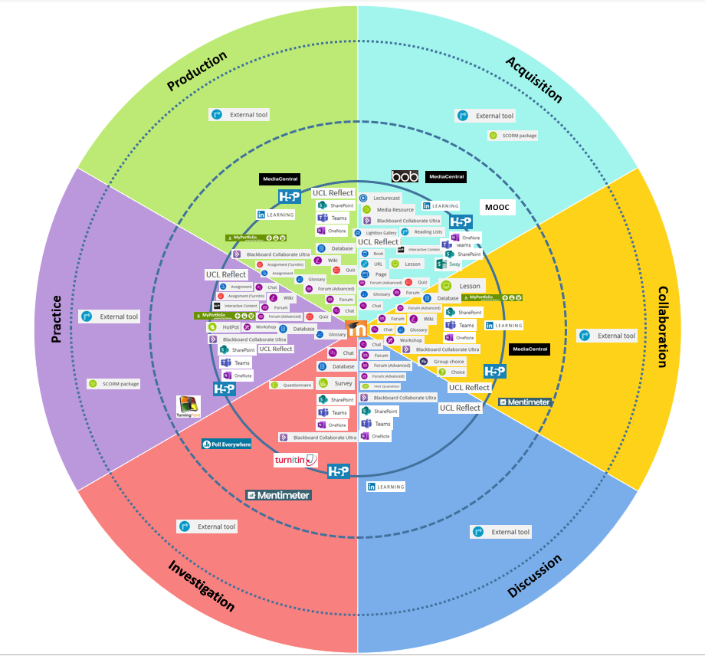
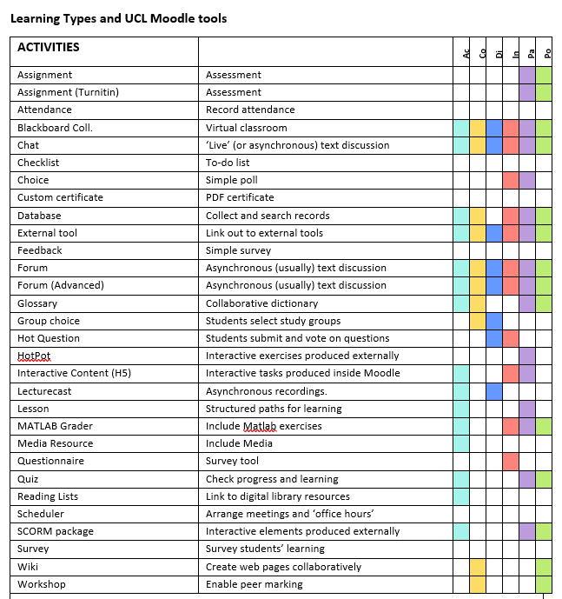
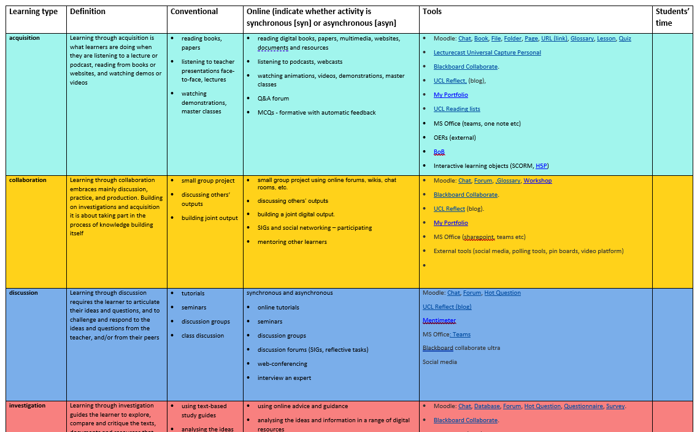
Mapping with Tech

Slide 8
Introducing the APT methodology: (Alignment of Pedagogy and Technology)
A structured way of thinking about a digital educational ecosystem designed to align the needs of teachers and learners with the affordances of digital technologies
Aims to find which digital technologies are most "apt“
New definition of affordance
Osborne, R., (2014). An ecological approach to educational technology: affordance as a design tool for aligning pedagogy and technology (Doctoral dissertation, University of Exeter).

Slide 9
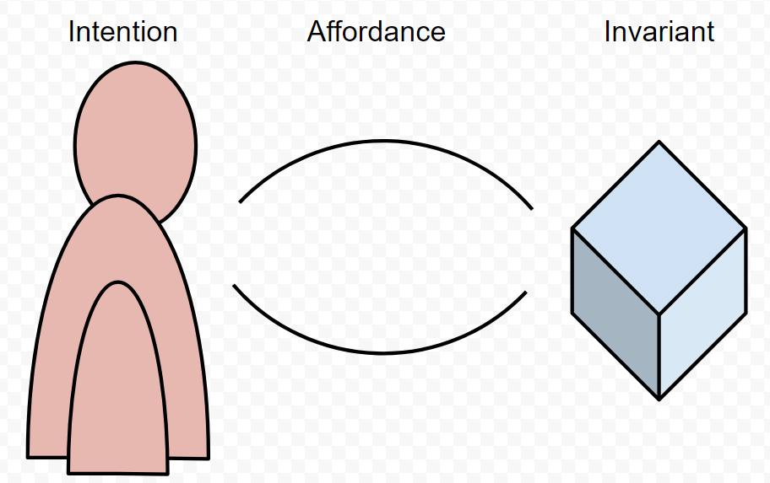
Affordance (according to Gibson)
"The affordances of the environment are what it offers the animal, what it provides or furnishes, either for good or ill.”
Gibson (1979)

Slide 10
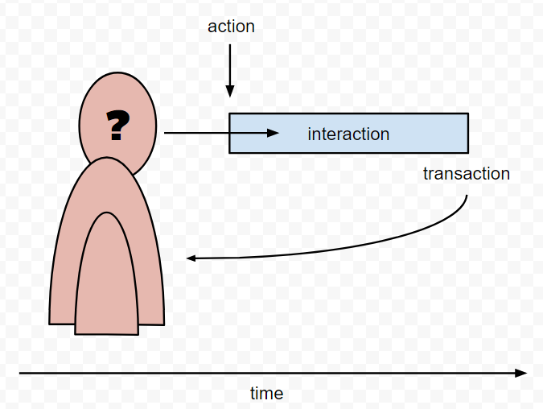
Affordance as ‘transaction possibilities’
An ‘action possibilities’ approach locates affordance here: individuals perceive the actions they can take in their environment
The HCI approach locates affordance here: individuals perceive how they can interact with objects in their environment, turning, pulling, twisting, etc.
A transactional approach locates affordance here: individuals perceive not actions or interactions, but rather the consequences of action (or inaction)
Notes:
This, more than anything, highlights the difference between Gibson and Norman. The designer is interested in interaction, how something might be used, but the educator is interested in transaction, what someone gains from use.
The designers chief aim in life is to ensure that the products that they create can be used. They are not necessarily interested in how their products change people. However the educator is entirely concerned with how to change people. Learning is, after all, a process of change. From Skinners experiments with stimulus and response, through Piaget’s theories of adaptation, on to Wenger’s notions of duality, change is implicit in all theories of learning. The educator is interested in how interactions in the world impact individuals, what they get back from interaction - not simply action, nor even the more complex interaction, but transaction.

Slide 11
How does the APT methodology work?
Choose a theoretical framework
Identify 10 key words to describe each ‘dimension’ of the framework
Rate affordances of relevant technologies

Slide 12
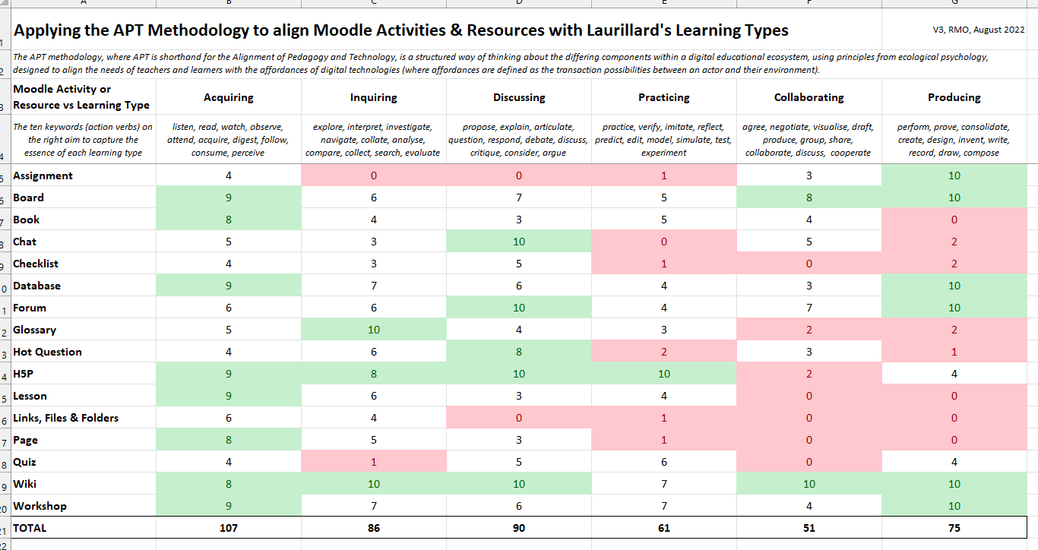

Slide 13
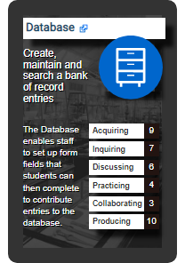
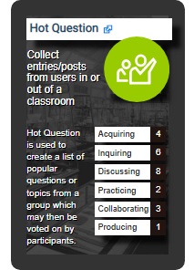
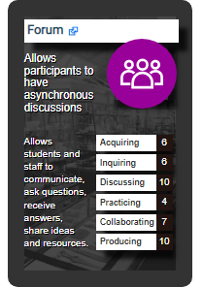
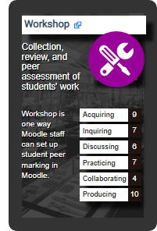
Creating ‘Tech Trumps’ for Moodle
Top Trump style
How well each Moodle activity and resource aligns with Laurillard’s six learning types
Highly practical and easy-to-use method for aligning an ABC learning design with specific Moodle activities and resources
http://techtrumps.co.uk/ucl/

Slide 15
Questions / Collaborations
Next Steps:
ABC in your context?
Validating the APT methodology
Expanding the range of digital tools
Resources:
ABC Learning Design @ UCL https://blogs.ucl.ac.uk/abc-ld/
Moodle Academy ABC https://moodle.academy/course/view.php?id=14
Learning Designer https://www.ucl.ac.uk/learning-designer/
Tech Trumps http://techtrumps.co.uk/ucl/

Slide 16
References
Gibson, J. J., (1979) The Ecological Approach to Visual Perception. Houghton Mifflin Harcourt (HMH), Boston.
Laurillard, D., (2013) Teaching as a design science: Building pedagogical patterns for learning and technology. Routledge, London.
Osborne, R., (2014) An ecological approach to educational technology: affordance as a design tool for aligning pedagogy and technology. (Doctoral dissertation, University of Exeter).
Young, C. and Perovic, N., (2016) Rapid and Creative Course Design: As Easy as ABC? Procedia – Social and Behavioral Sciences, no. 228, pp. 390-395.

