Slide 1
Advanced Grading:
creating efficiencies with moodle rubrics
MoodleMoot Global 22
Julia Avenell
Jane Newton
Notes:
Hulio

Slide 2
"Moodle is a journey of utlising the features better and better."
Abby Fry, The Moodle Podcast, August 2022
Back to Agenda Page
Notes:
Jane
So, what is a rubric?
A rubric is typically an evaluation tool, to measure attainment against a consistent set of criteria. Rubrics are really useful in helping to position students against a set of learning standards, and it helps determine how well they have met certain learning outcomes.

Slide 3
Who we are:
PURPOSE
To support the Australian screen and broadcast industries by fostering Australian storytelling talent
LOCATION
Sydney Australia
STUDENTS
360 students in Award Programs aged 17 to 58 from all over Australia
Notes:
Jane
AFTRS was established in 1973 under an act of Federal Parliament, so we're turning 50 next year! Our campus is in Sydney.
Our purpose is to support the next generation of Australian storytellers, through teaching all facets of film production and broadcast: writing, directing, producing, cinematography, editing, design and sound.

Slide 4
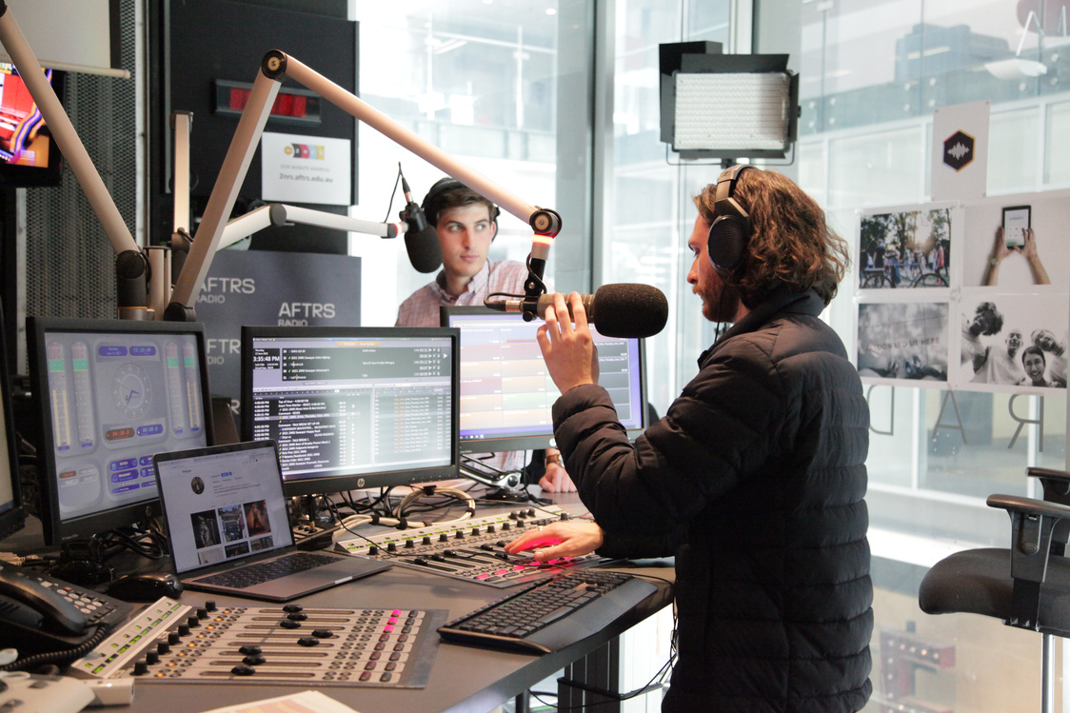
Bachelor of Arts Screen: Production
Master of Arts Screen
​Master of Arts Screen: Business
Graduate Diploma in Radio​ & Podcasting ​
Graduate Diploma in Visual Effects
Short Courses and Industry Certificates
What we teach:
Students engage with hands-on, immersive learning, in an environment that mirrors industry standards. All of our Award Programs are delivered face to face, with Moodle being used to support what is predominately practice based learning.
Notes:
Julia

Slide 5
A rubric is typically an evaluation tool or set of guidelines to measure attainment against a consistent set of criteria. Rubrics clearly define academic expectations for students and help to ensure consistency in the evaluation of academic achievement. Rubrics are also used as scoring instruments to determine grades or the degree to which learning standards have been demonstrated by students.
https://www.edglossary.org/rubric/ .
Back to Agenda Page
Notes:
Jane
So, what is a rubric?
A rubric is typically an evaluation tool, to measure attainment against a consistent set of criteria. Rubrics are really useful in helping to position students against a set of learning standards, and it helps determine how well they have met certain learning outcomes.

Slide 6
To expedite the marking process, given our large cohorts and multiple markers
To ensure academic rigour and an assessment strategy that could be easily moderated
To ensure accurate grading - the online rubric provides an "electronic scorecard" therefore no maths required
To save time uploading marked up copies of the rubrics for students
To encourage students to engage with the rubric before doing the assessment - Moodle rubrics display on the Assignment page so readily visible
Why we use Moodle Rubrics
Notes:
Jane
Why do we use rubrics?
AFTRS uses rubrics as our primary assessment tool. A big part of the reason for doing this is it helps us to mark efficiently and consistently across large cohorts and with multiple markers. Using inbuilt Moodle rubrics, with grades being calculated automatically in the back-end, it means fewer errors and miscalculations by markers; plus, the grades are immediately visible to students and we don't need to upload separate marking sheets.
Rubrics are a useful tool for student self-evaluation too, and we encourage our students to review their rubrics before they submit their work so they can verify whether they have met all the required criteria.

Slide 7
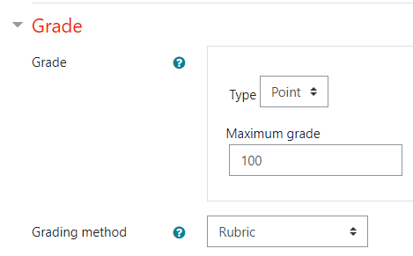
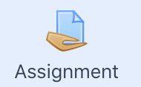
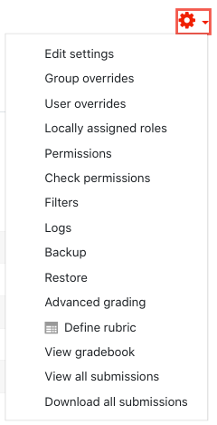
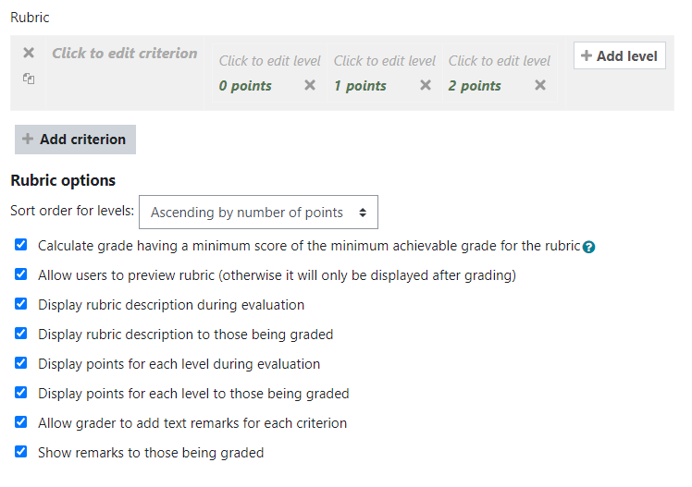
How to start building a Moodle rubric

Slide 8
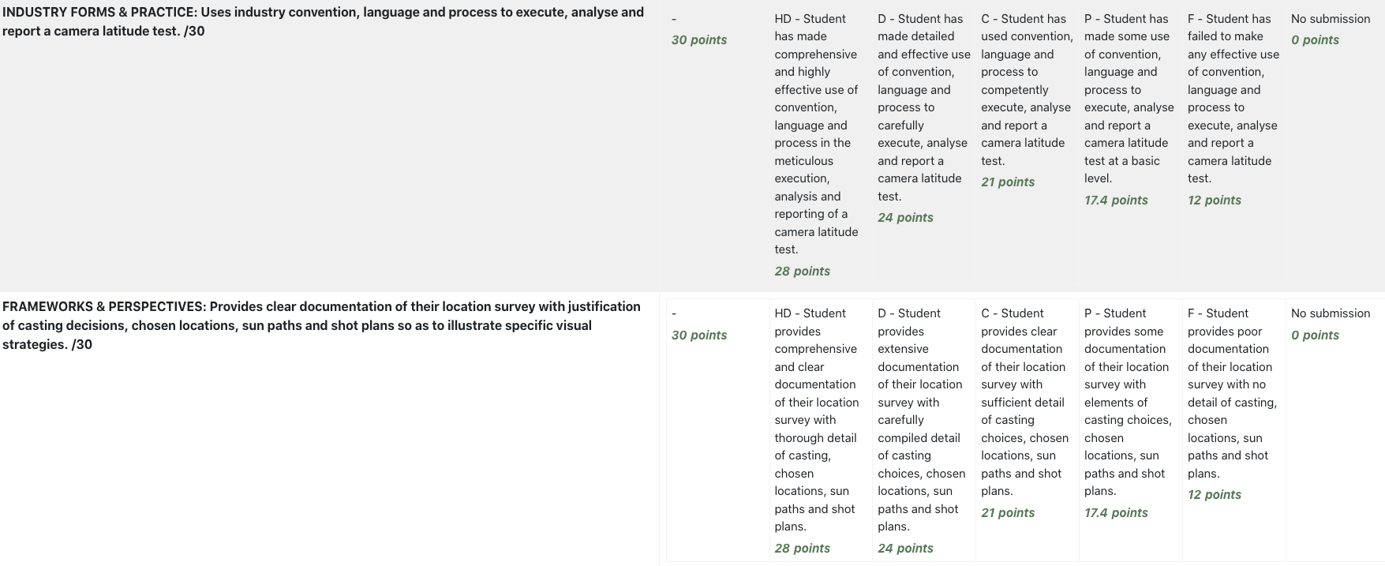
Tip!
Make all rubrics graded out of 100
The final product will look something like this...
GRADE BANDS
MARKING CRITERIA
t of 100
MEDIAN OF GRADE BAND
Rubrics calculate based on the medians but you can manually moderate if required.

Slide 9
Indicators are concise and unambiguous
The required output against each criterion is tangible and demonstrable
Students should be able to self-assess prior to making their submission: rubrics should be available to review in advance
Avoids jargon or highly technical academic language
Each criterion is not overloaded: it should ask for a clear and distinct outcome
Students should be able to glean feedback on their submission based on the rubric indicators
What makes a good rubric?
Notes:
Jane
Not all rubrics are created equally..! And a poorly-worded or overly complicated rubric can make marking really challenging. Ideally the markers shouldn't need to exercise their subjective discretion when awarding a grade: the indicators should support the marker in selecting the appropriate grade for each student.
The best rubrics are those where the indicators are concise and unambiguous, and each criterion should ask for a specific and tangible output.
Students themselves should also be able to use the rubric as a form of feedback: see where against the indicators they have been graded, and understand the feedback contained within it.

Slide 10
Engaging students with rubrics:
Build rubrics into peer-to-peer assessment - usually best for formative assessment
Accompany exemplars with corresponding marked rubrics
Get student input on rubric design
Provide video explainers
Notes:
Jane
Student input can really assist in the design of a good rubric. Ensuring students understand the assessment requirements and even having them co-determine the rubric can be a great way to engage them.
Providing examples of 'rubrics in practice' - that is, exemplar student work with a marked rubric alongside - can be a useful benchmarking tool for students as they prepare their own assessments.
Providing fun video explainers has been one way AFTRS staff have helped our students to engage with their assessment tools.

Slide 11
Notes:
Jane

Slide 12
Bottlenecks and
gradebook limitations
CHALLENGE
Moodle cannot easily deduct late penalties Late penalties must be applied manually But when using Moodle rubrics grades need to be released to make manual adjustments In our workflow only Course Convenors can release & adjust the grade at the "Assessment Panel" Result = fiddly work = inconsistencies in application of penalties & errors
Back to Agenda Page
Notes:
Julia

Slide 13
SOLUTION
Use the online rubric to deduct the late penalties!
Back to Agenda Page
Notes:
Julia

Slide 14
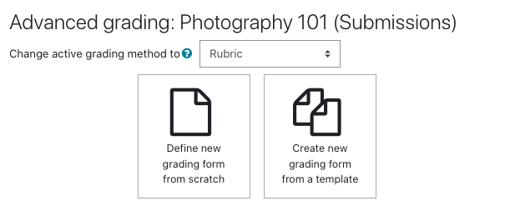
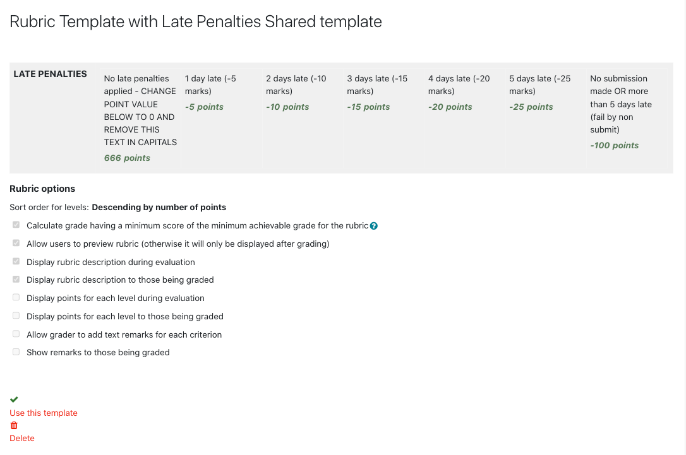
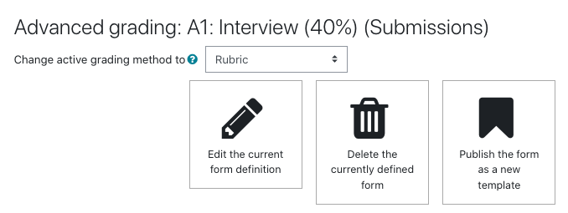
Other efficiencies:
CREATE
Publish frequently used rubrics as templates
Tip! Set a naming convention so you can search and find templates easily.
PUBLISH
Notes:
Julia

Slide 15
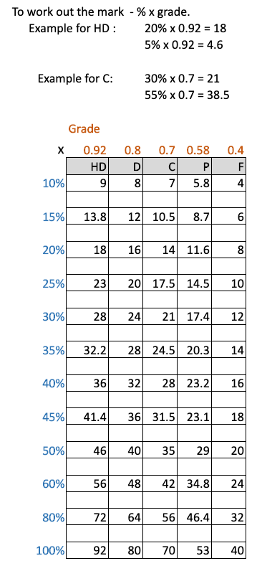
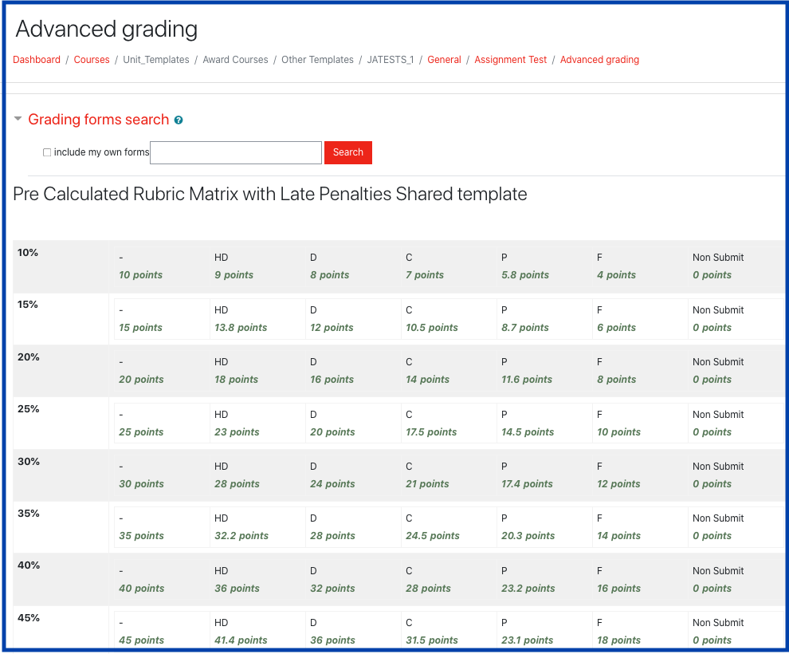
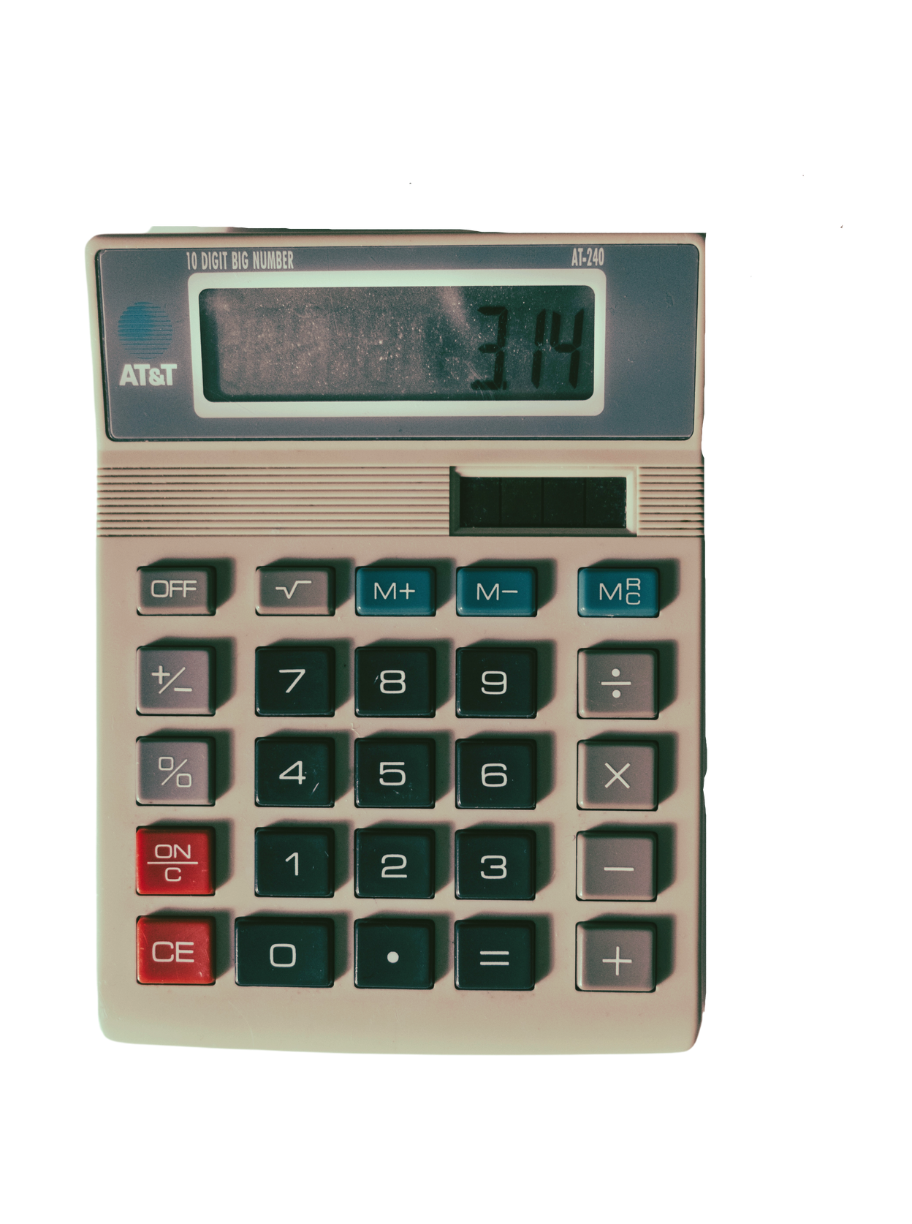
Other efficiencies:
Use a pre-caclulated matrix of grade band weightings
PUBLISHED AS A TEMPLATE
Notes:
Julia

Slide 16
Feedback from students:
Students loved the video and want more like it
Students said video ensured fairness because each class got the same info
Students say rubrics make them more aware of how staff interpret their work
Notes:
Jane
The feedback from students about the video explainer we just watched was extremely positive. By using humour and a light but informative approach, students were made familiar with the rubric and assessment requirements.

Slide 17
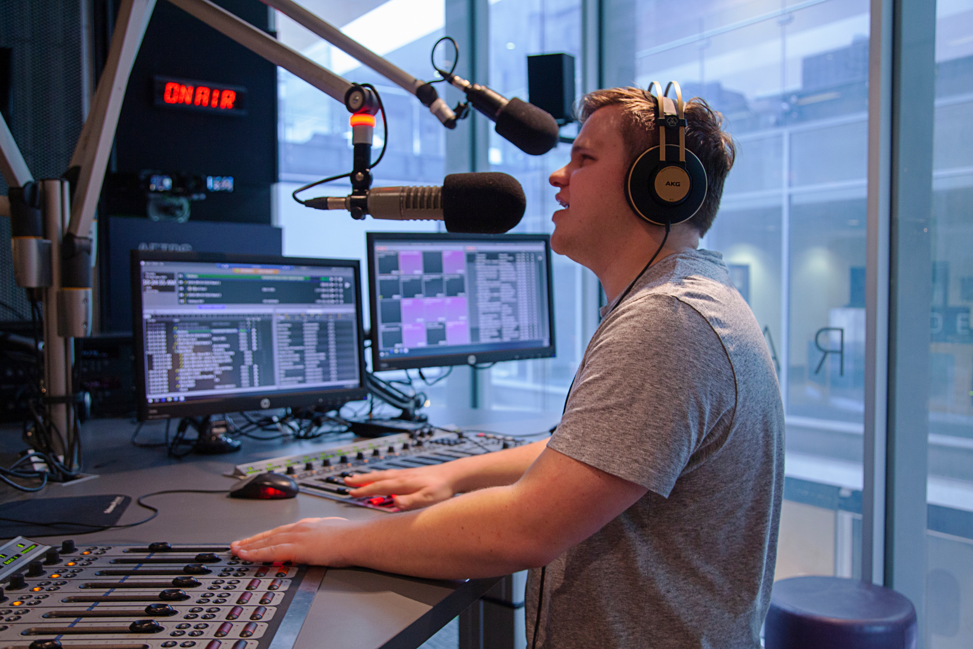
Feedback from staff:
Assessment briefs and approach to marking was consistently-messaged across different classes doing the same work
Graders became more aware of the rigour surrounding assesment guidelines
Assisted consistency during Moderation process
Notes:
Jane
The feedback from students about the video explainer we just watched was extremely positive. By using humour and a light but informative approach, students were made familiar with the rubric and assessment requirements.

Slide 18
Thank you!
Do you have any questions?
Contact us at learning@aftrs.edu.au

