Slide 1

A Virtual Escape Room
Using H5P, Access Restrictions and a Compelling narrative to build Confidence and Community among First-year students
Edd Bolton, MA, FHEA
Learning Technologist
Dr. Kassie Cigliana, PhD, FHEA
Instructional Designer
Tom Gray, MSc, FHEA
Senior Lecturer, Sport and Exercise Therapy

Slide 2

In today's talk:
Introduction for the student escape room
Why use an escape room?
Demo of escape room
Technical considerations
Feedback
Impact

Slide 3

Virtual Escape Room Introduction for BA (Hons) Sport and Exercise Therapy

Slide 4
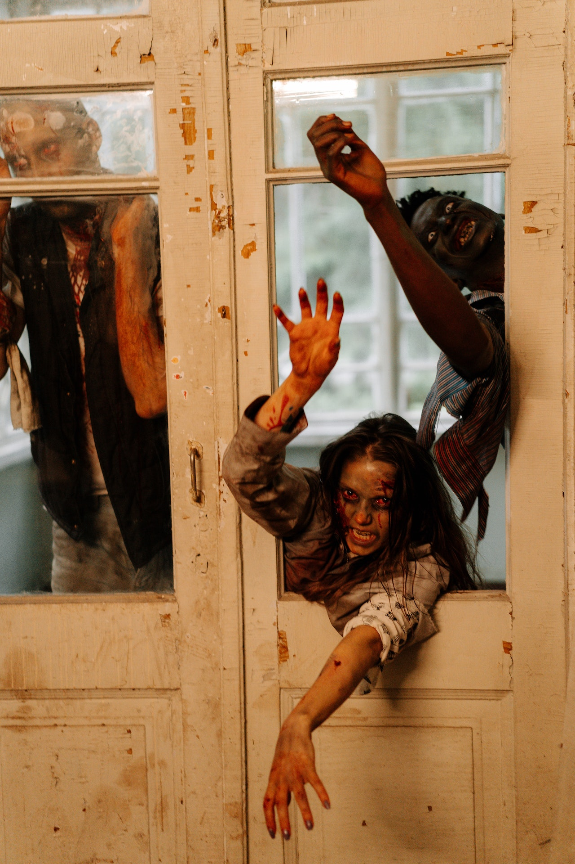
Why an escape room?
  Founded in pedagogies around problem-based and experiential learning (García, et al., 2016; Kolb, 1984; Othman, et al., 2017)
  Narrative-driven to promote engagement
  Community building, learning through participation (Dewey, 1963)
  Development of 'essential' skills, such as teamwork (Ho 2018), critical-thinking (Adams et al. 2018), and problem-solving (Foster and Warwick 2018)
  Familiarity with Moodle
  Building relationships with other students and course team members
"Helps to maintain the students' engagement and enjoyment, while subliminally adding in some learning"​

Slide 5
Virtual Escape Room
Current Version Moodle 3.9.15
Internal link only

Slide 6

Technical Constraints
Benefits
  Foundations of an ongoing course community
  Scalable: Can be made available to a large cohort to complete simultaneously​
  Reusable: Easy to reuse year after year​
  Mirrors other virtual activities on the course
  Time to build
    Scenario (Tutor): ~1 hour to write
    Activities / H5P (Tutor): 5+ hours to develop
    Tools and mechanics (Developers): ~2 hours to implement
  "Difficulty": Non-specialists may need support with the build
  Tedious mechanics of conditional release

Slide 7
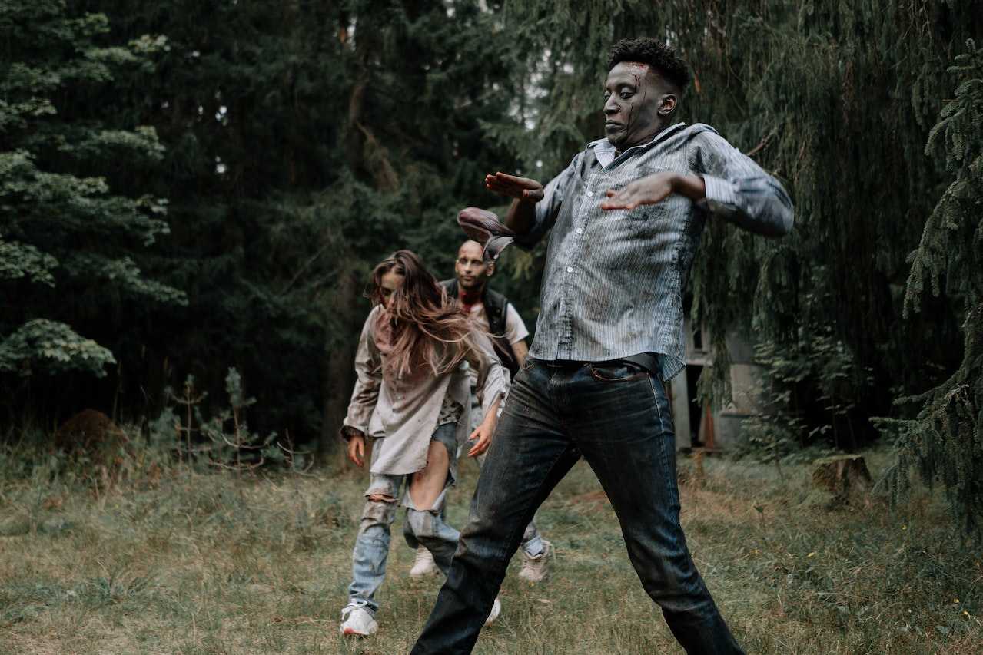
Technical Considerations
Moodle 4
  Migration to of content Moodle 4
  Migration of H5P to content bank
  Navigation:
    Instructions now within activities
    H5P Interactive book for multi-part activities
    Navigation on left side menu
    Reminding students to 'refresh' page after completing each activity

Slide 8
Feedback
What did you enjoy about the escape room experience?
What would have improved the Virtual Escape Room experience?
Probably the best induction session I’ve done
Really good motivation
It’s good to be able to work as a team
More fun than sitting at a book reading
Innovative
Challenging
It was good. It felt like an actual experience, like the one I’ve done before
Physically being able to do it
Actually being in the room
Doing it in real life
It would have been even better in person, although we may have argued more
We had to go at your pace

Slide 9
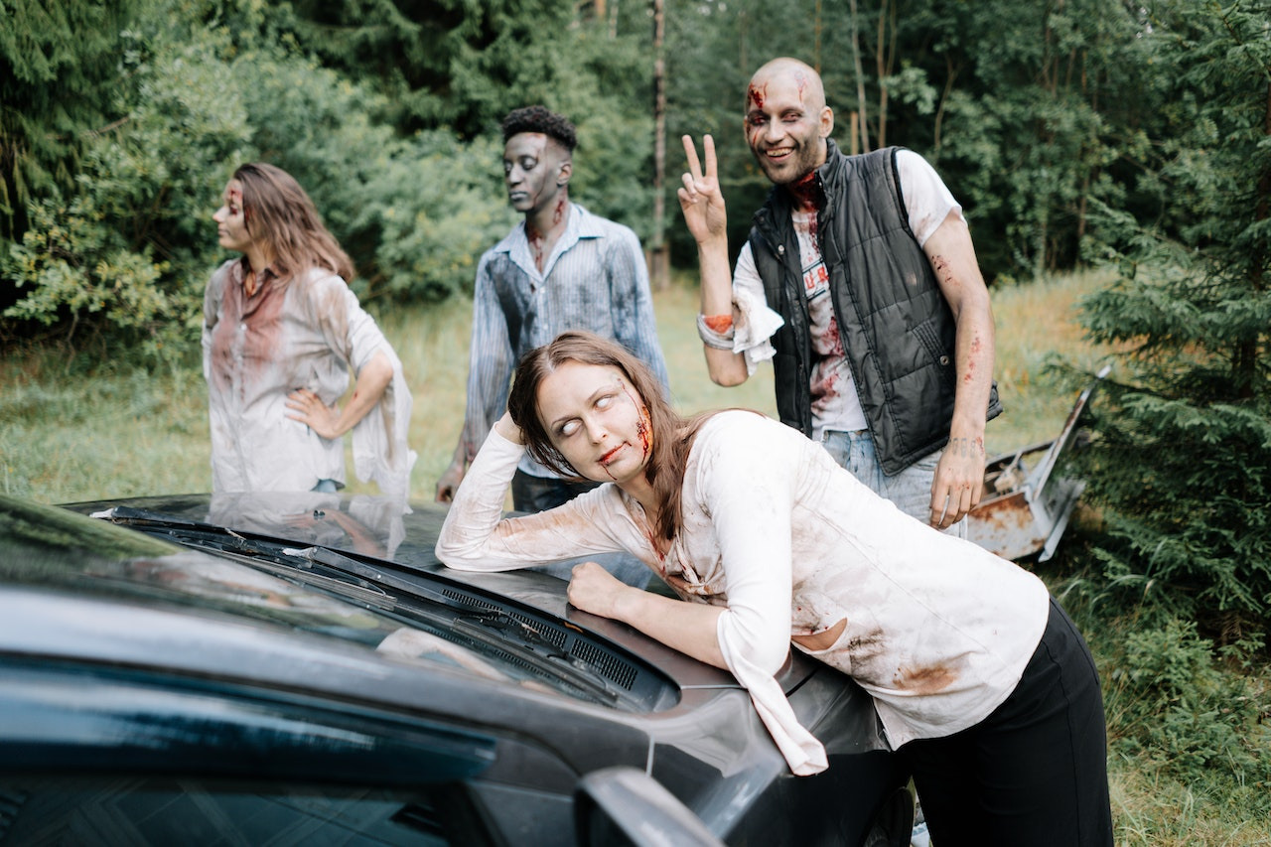
Impact
Students reported improved confidence in:
Critical thinking
Organisation
Interpersonal skills
Students were really engaged with the competitive nature of the activity, and it really got them thinking.
I think it helped to break the ice with the [first year] students; they worked well together because they all wanted to win.
- Tom Gray

Slide 10
References
ADAMS, V. et al., 2018. Can You Escape? Creating an Escape Room to Facilitate Active Learning. Journal for Nurses in Professional Development
DEWEY, J., 1963. Experience and Education. New York: Collier Books
FOSTER, T. and S. WARWICK, 2018. Nostalgia, gamification and staff development – Moving staff training away from didactic delivery. Research in Learning Technology
GARCÍA, M.G. et al., 2016. Development and evaluation of the team work skill in university contexts. Are virtual environments effective? International Journal of Educational Technology in Higher Education
HERMANNS, M. et al., 2017. Using an “Escape Room” toolbox approach to enhance pharmacology education. Journal of Nursing Education and Practice
HO, A.M., 2018. Unlocking Ideas: Using Escape Room Puzzles in a Cryptography Classroom. PRIMUS
KOLB, D.A., 1984. Experiential Learning: Experience as The Source of Learning and Development. Prentice Hall, Inc.
NICHOLSON, S., 2015. Peeking Behind the Locked Door: A Survey of Escape Room Facilities. White Paper
OTHMAN, H. et al., 2017. Engineering Students: Enhancing Employability Skills through PBL. In: IOP Conference Series: Materials Science and Engineering
SUBHASH, S. and E.A. CUDNEY, 2018. Gamified learning in higher education: A systematic review of the literature. Computers in Human Behavior

Slide 11
Thank you!
Contact
Edd Bolton
Dr. Kassie Cigliana
Edd.bolton@solent.ac.uk
East Park Terrace
Southampton
SO14 0YN
United Kingdom
Kassie.cigliana@solent.ac.uk
East Park Terrace
Southampton
SO14 0YN
United Kingdom

Slide 12
Moodle 3.9 screenshots

Slide 13
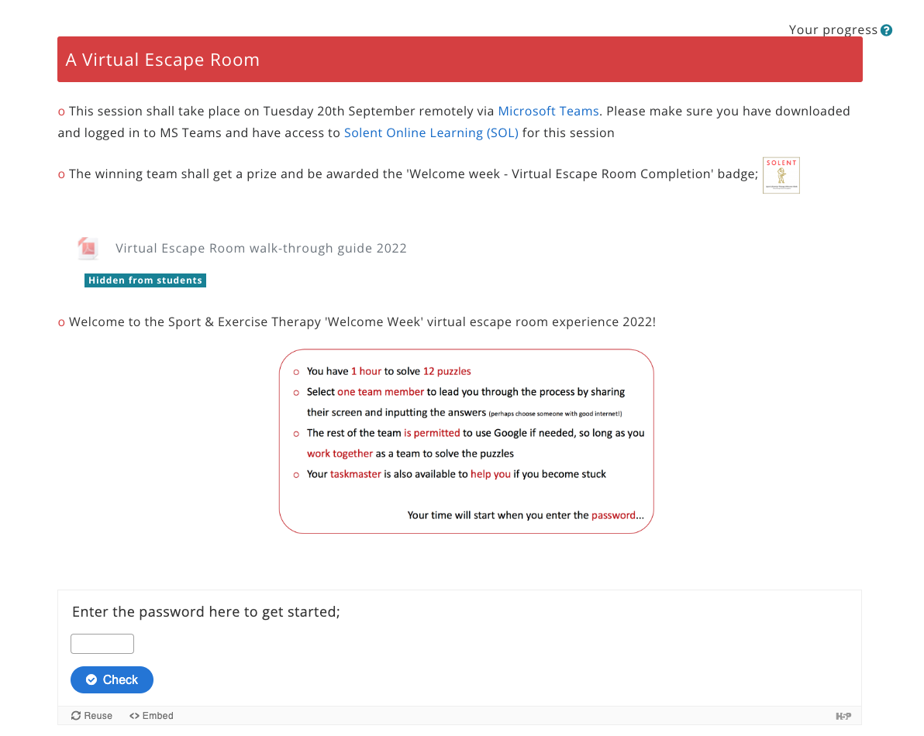

Slide 14
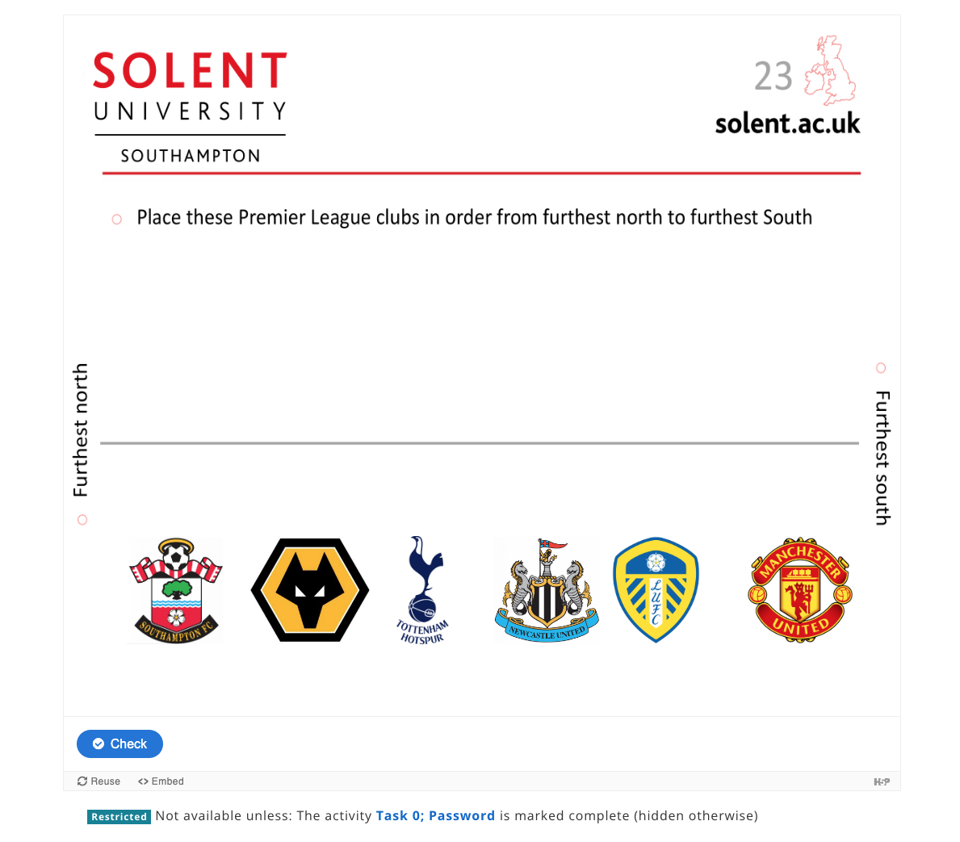

Slide 15
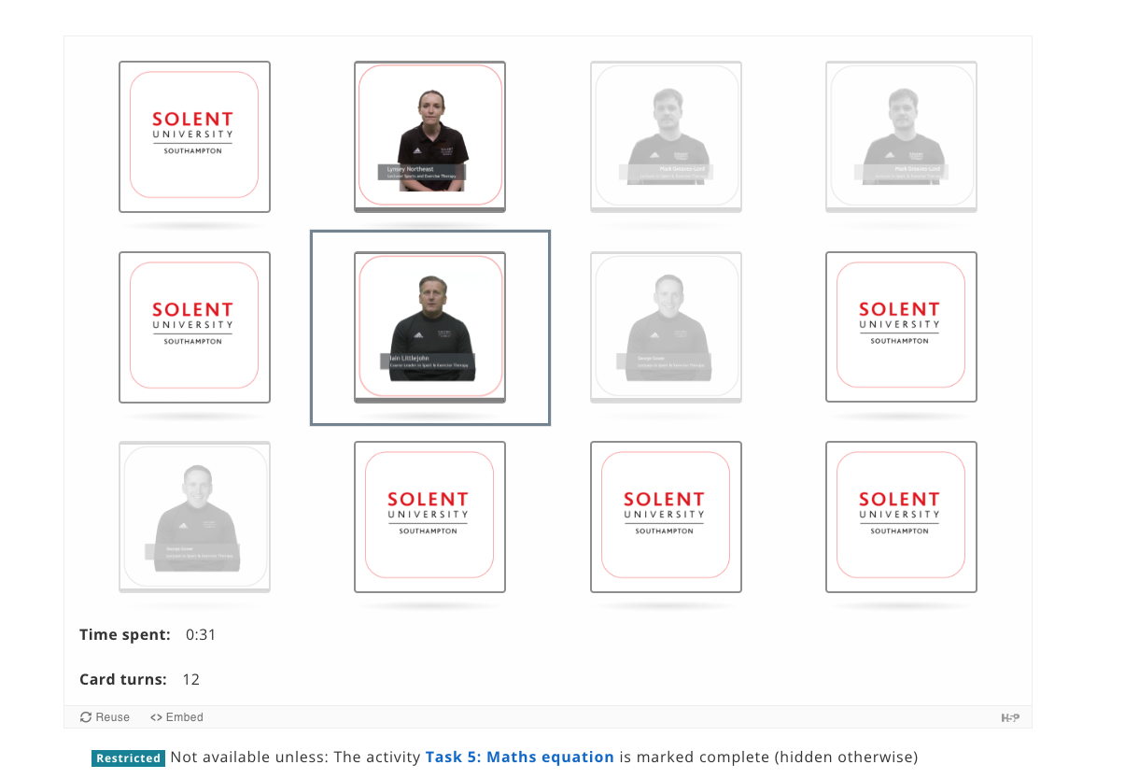

Slide 16
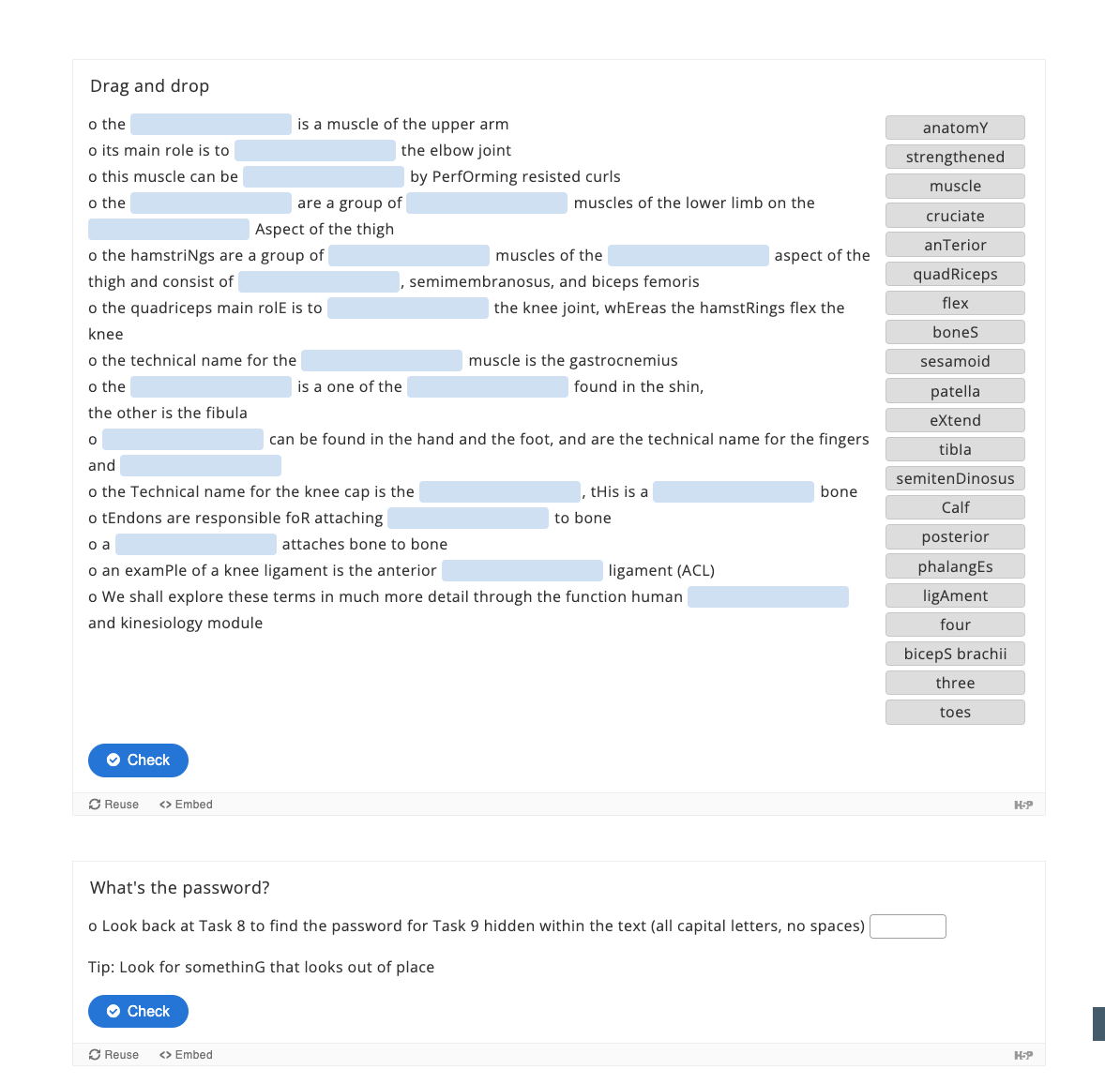

Slide 17
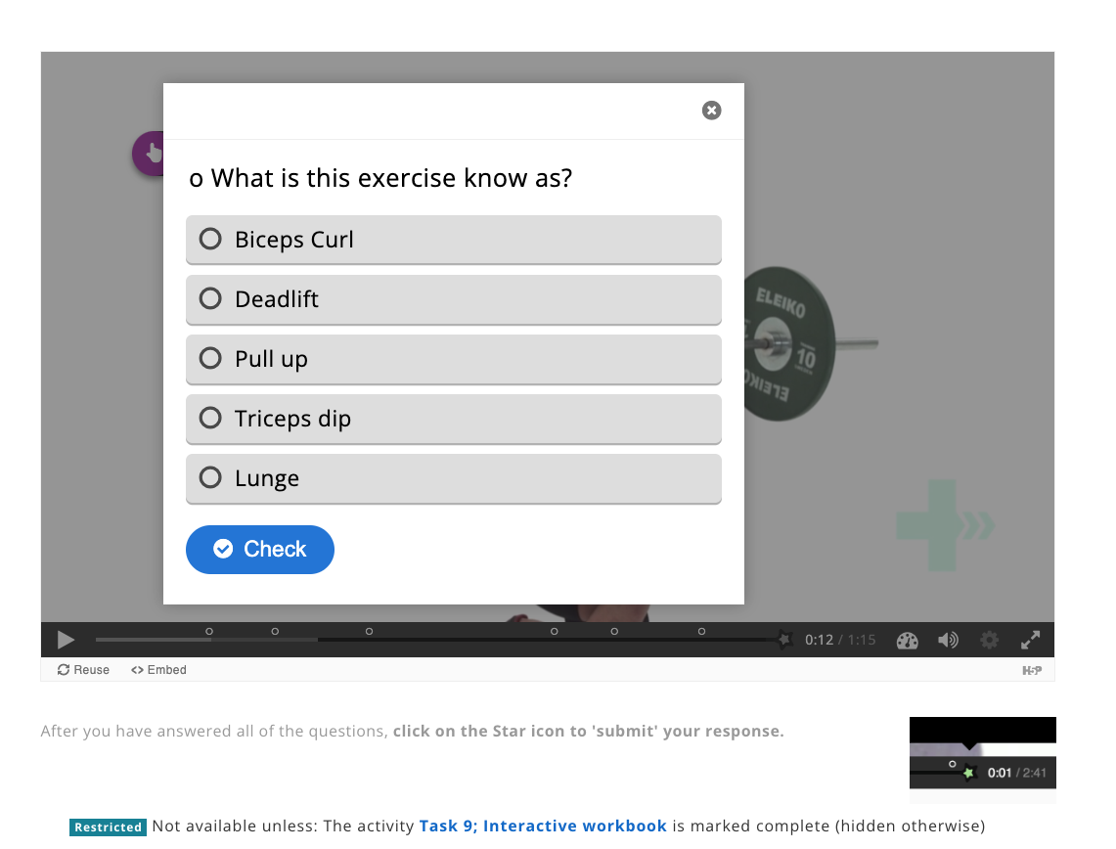

Slide 18
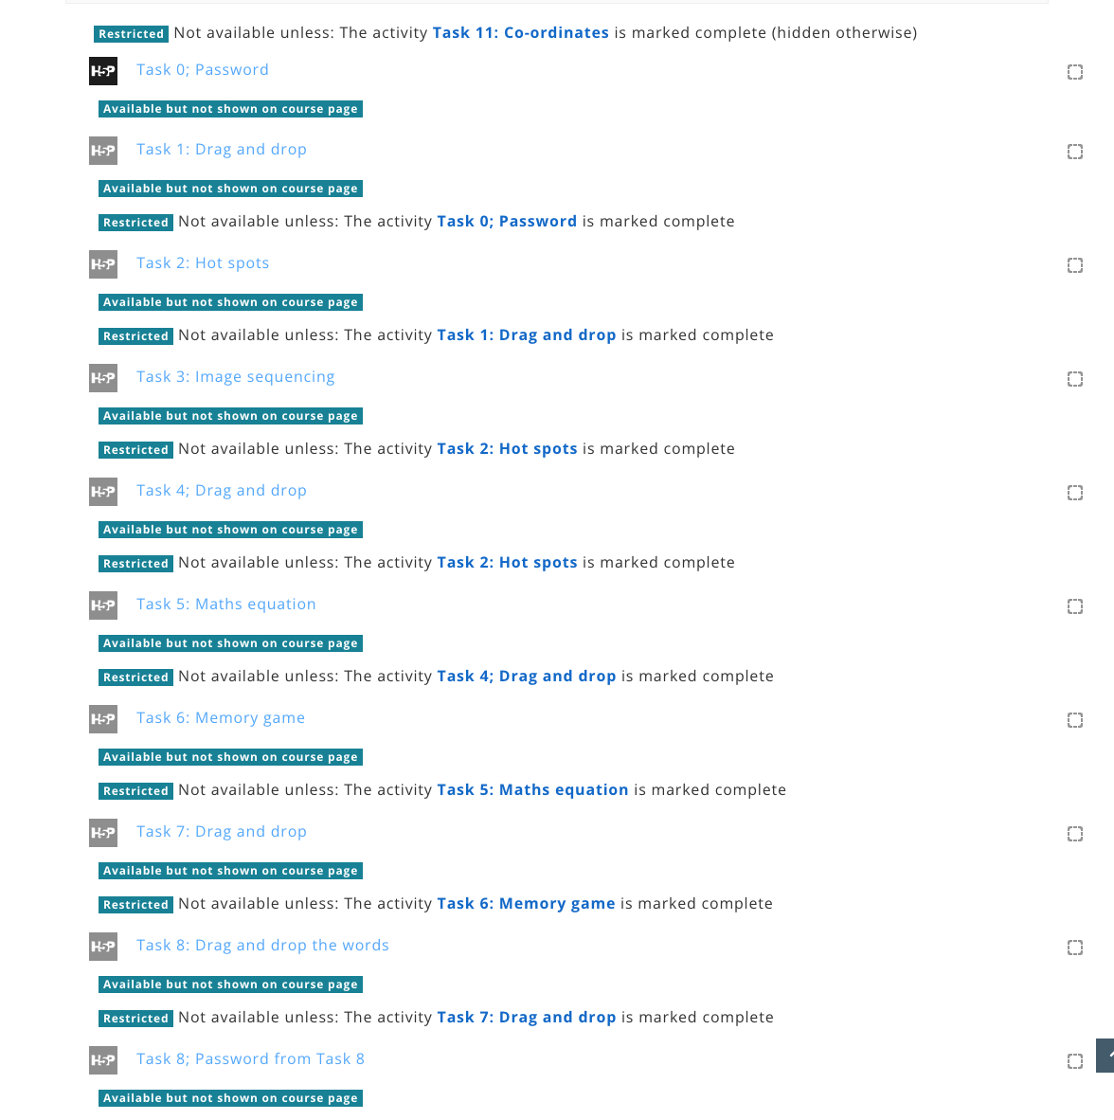

Slide 19
Moodle 4.0 screenshots

Slide 20
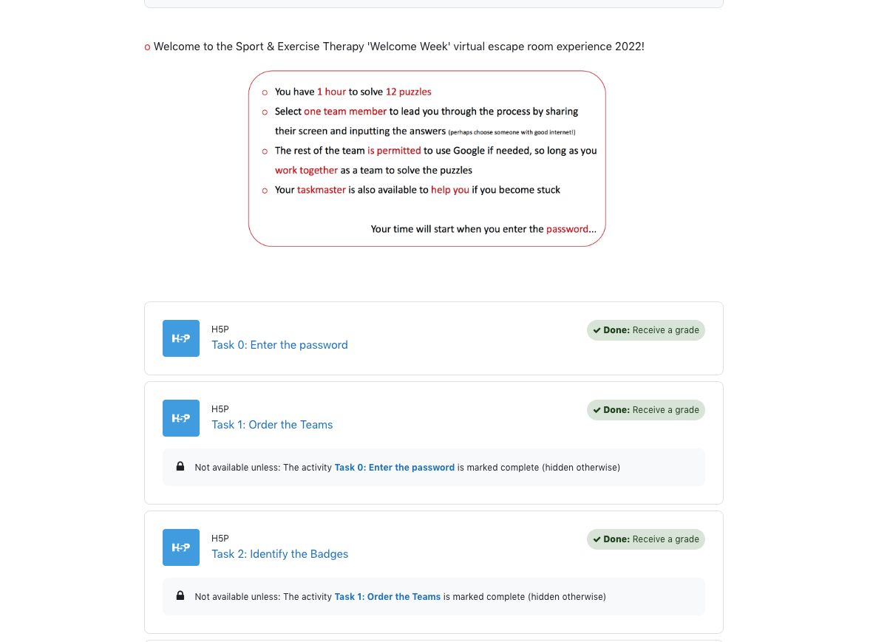

Slide 21
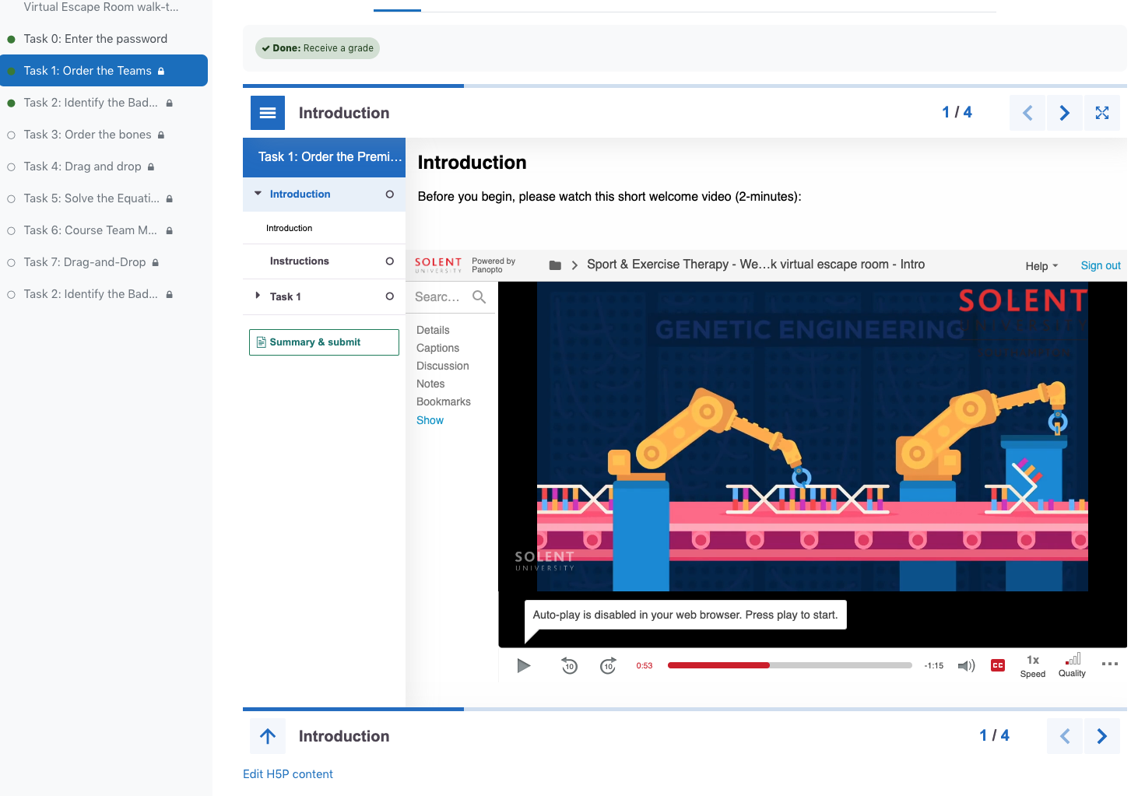

Slide 22
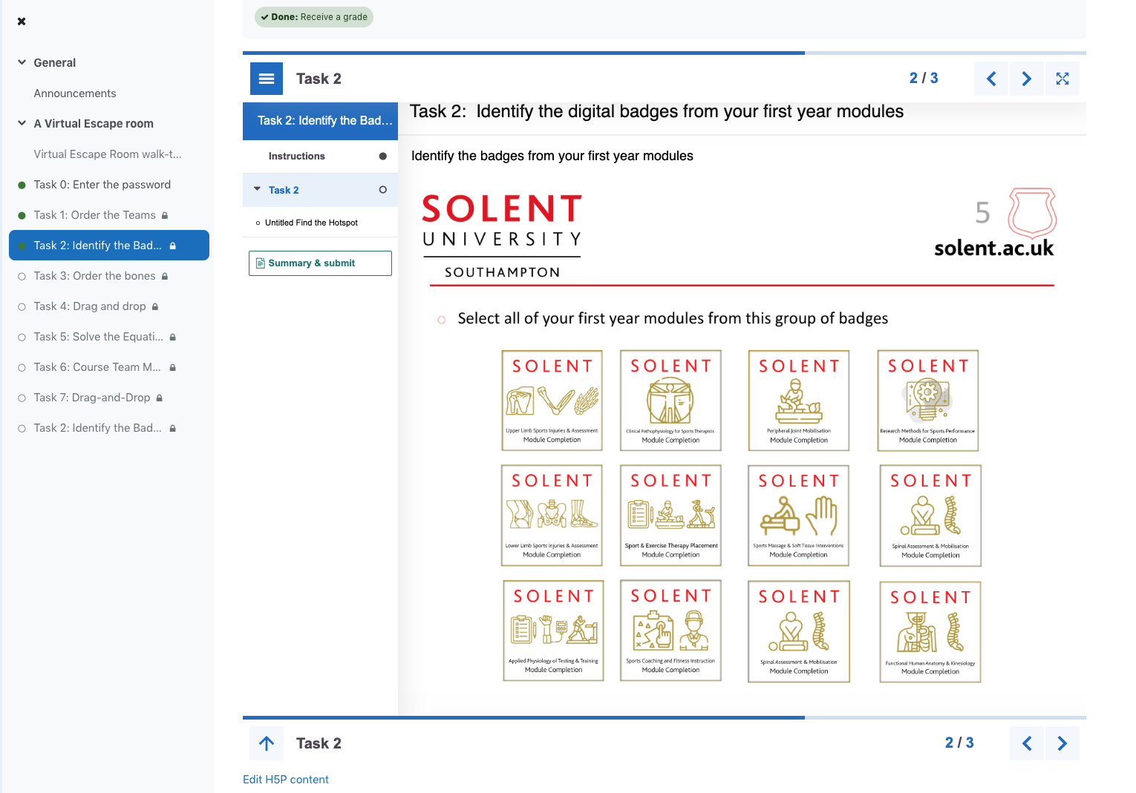

Slide 23
