Slide 1
5 Awesome Ways to use the Database Activity
Sarah Ashley
Solutions Architect

Slide 2
5 Awesome Ways to use the Database Activity
Sarah Ashley
Solutions Architect, Moodle US

Slide 3
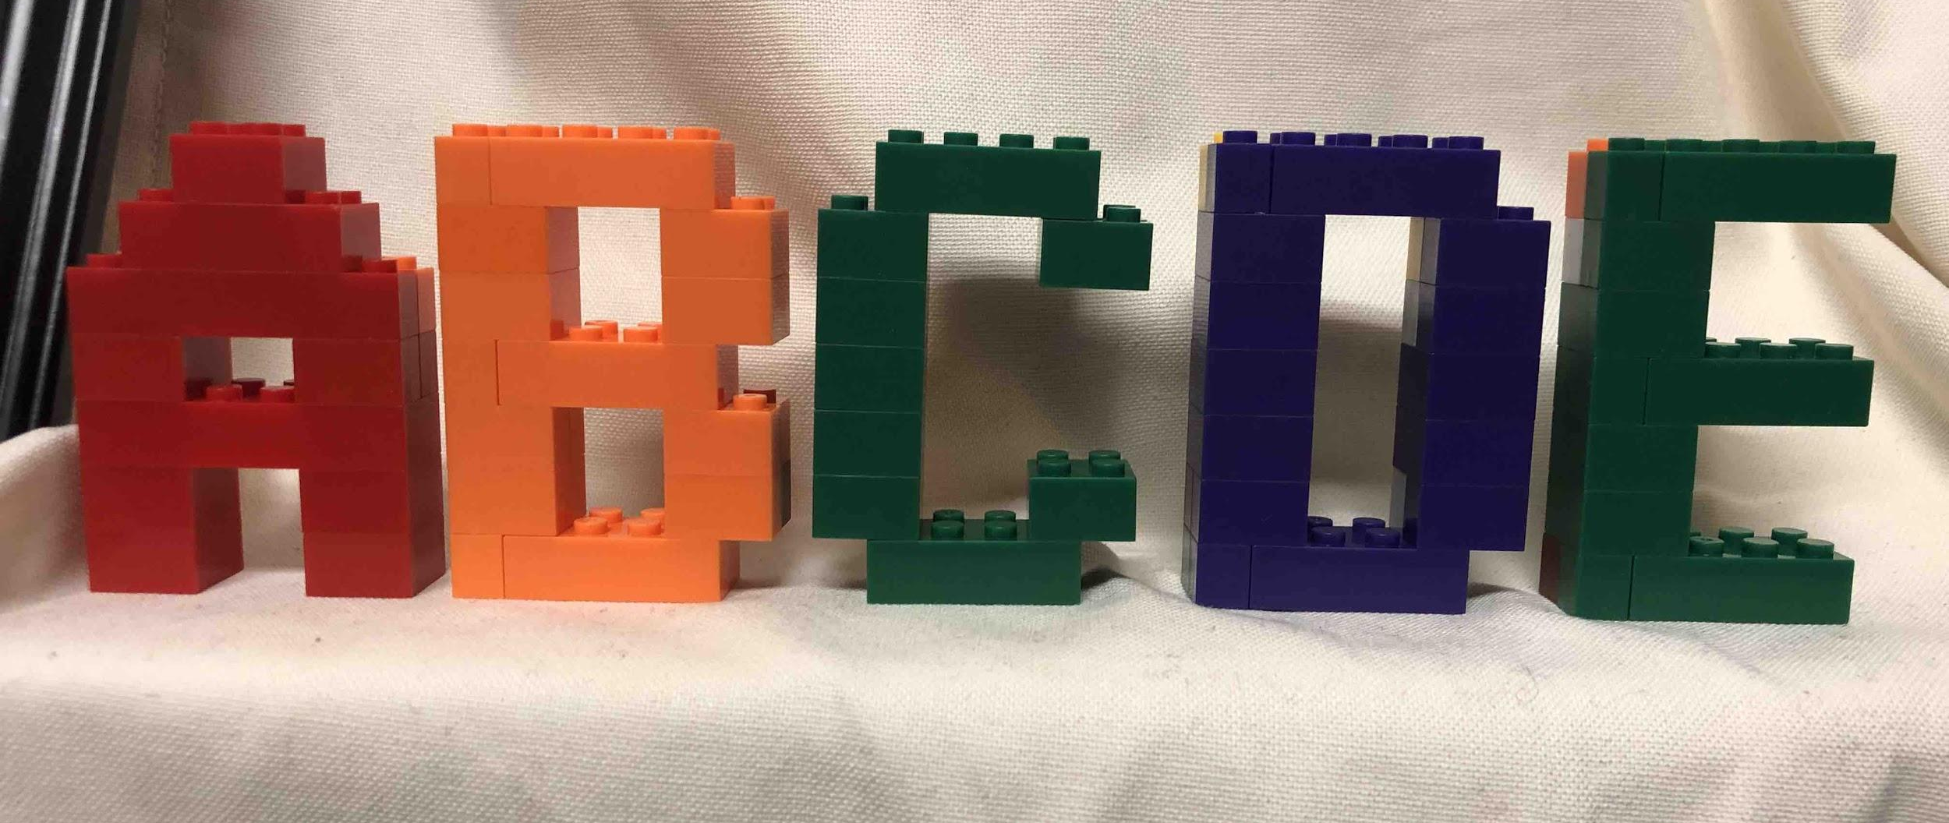
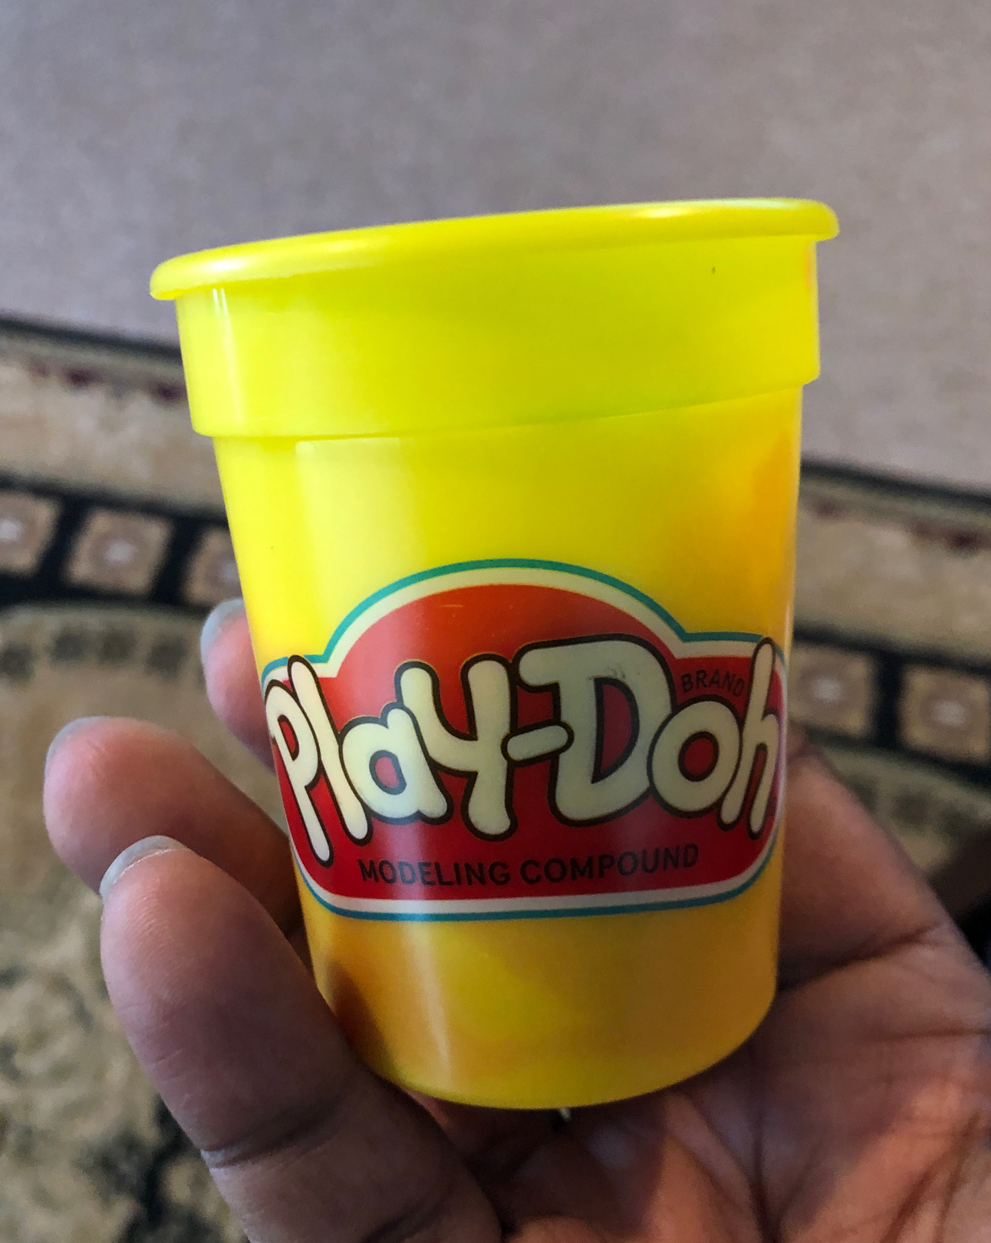
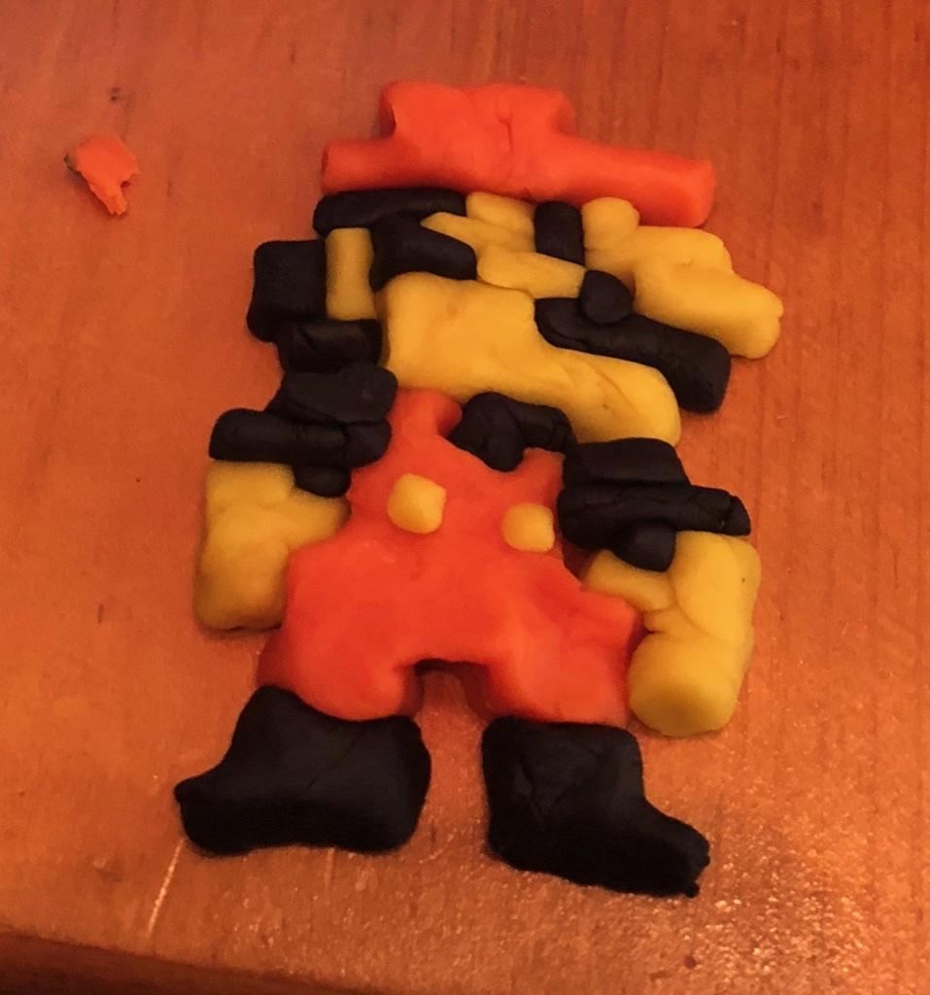
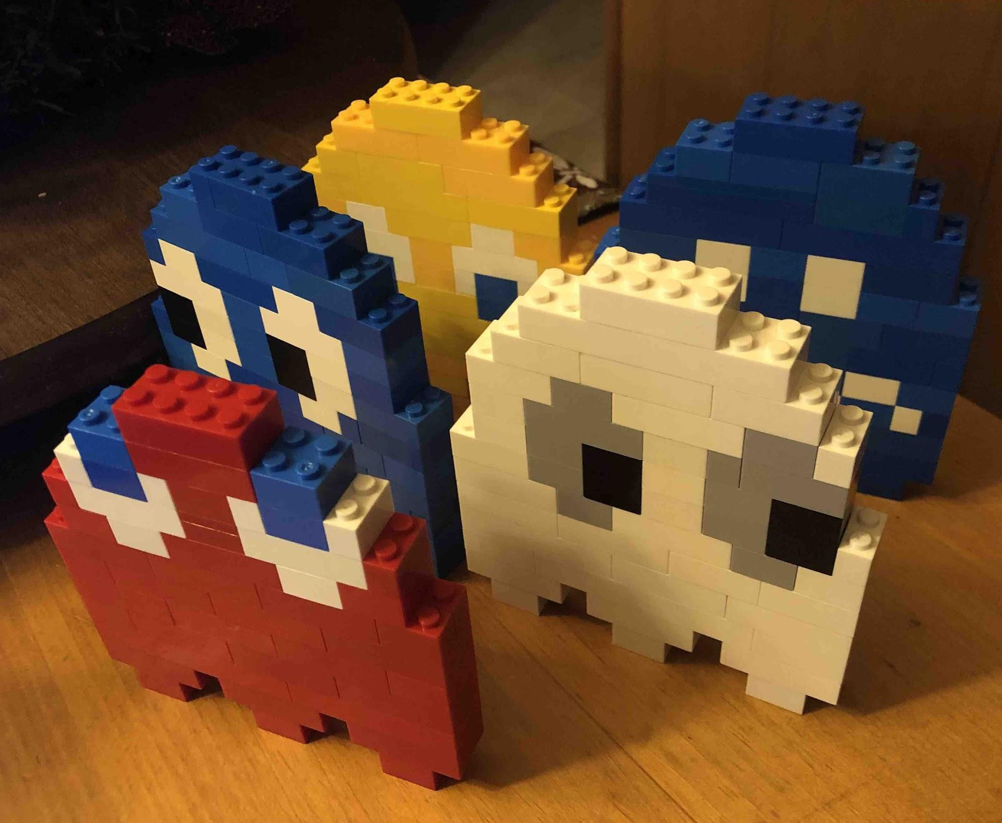
Simple
Complex
Notes:
Headline, image and dot points slide

Slide 4
3 Key Characteristics
multi-purpose
portable
import/reuse
archive/export
academic/learning
non-academic/clerical
group/team-based
individual/private
adaptable
Notes:
Headline, image and dot points slide

Slide 5
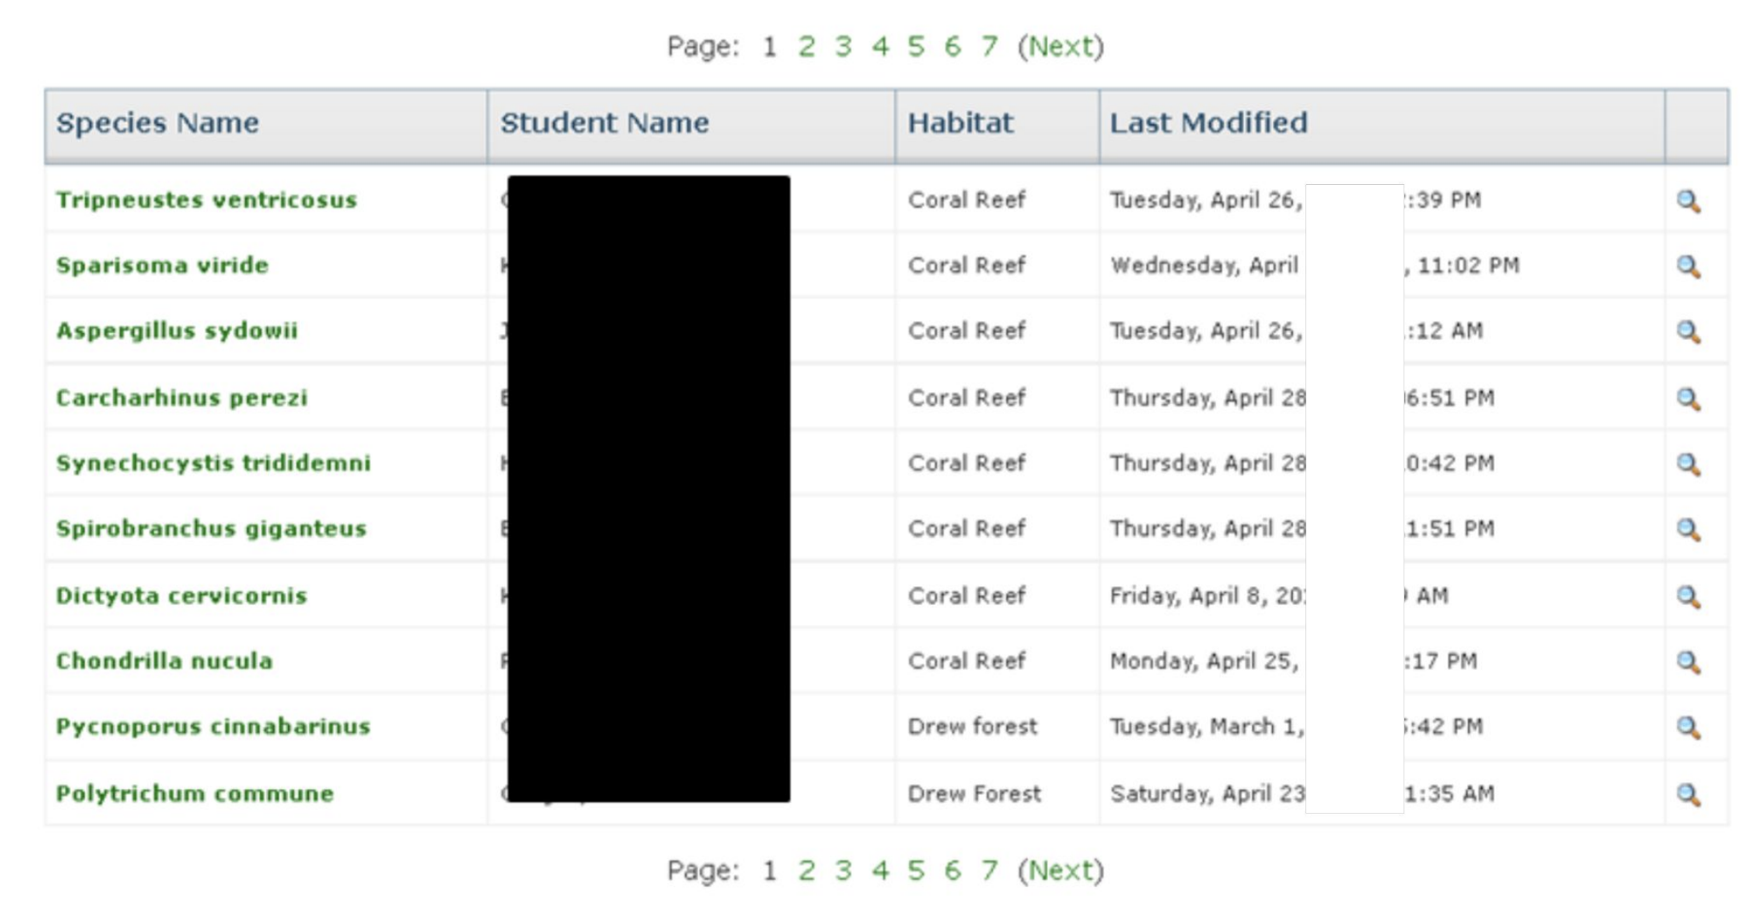
#1 Crowd-Sourced Website
Problem: Students waste time learning HTML & how to build a website and get frustrated

Slide 6
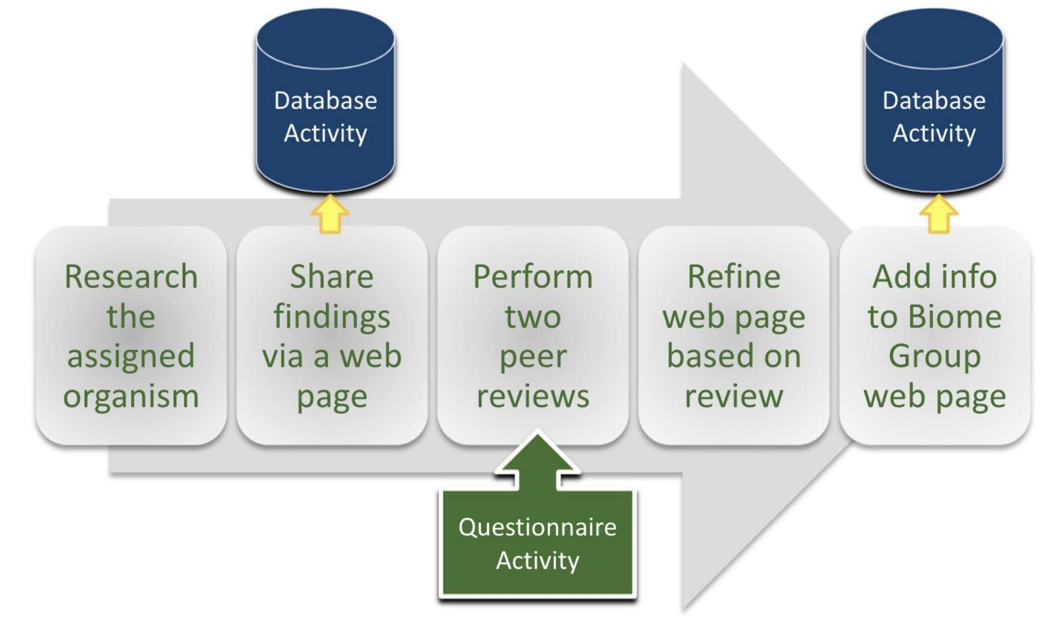
Academic / Individual ➔ Team / Peer
Standardized form for students to fill in data about their assigned organism, species or topic

Slide 7
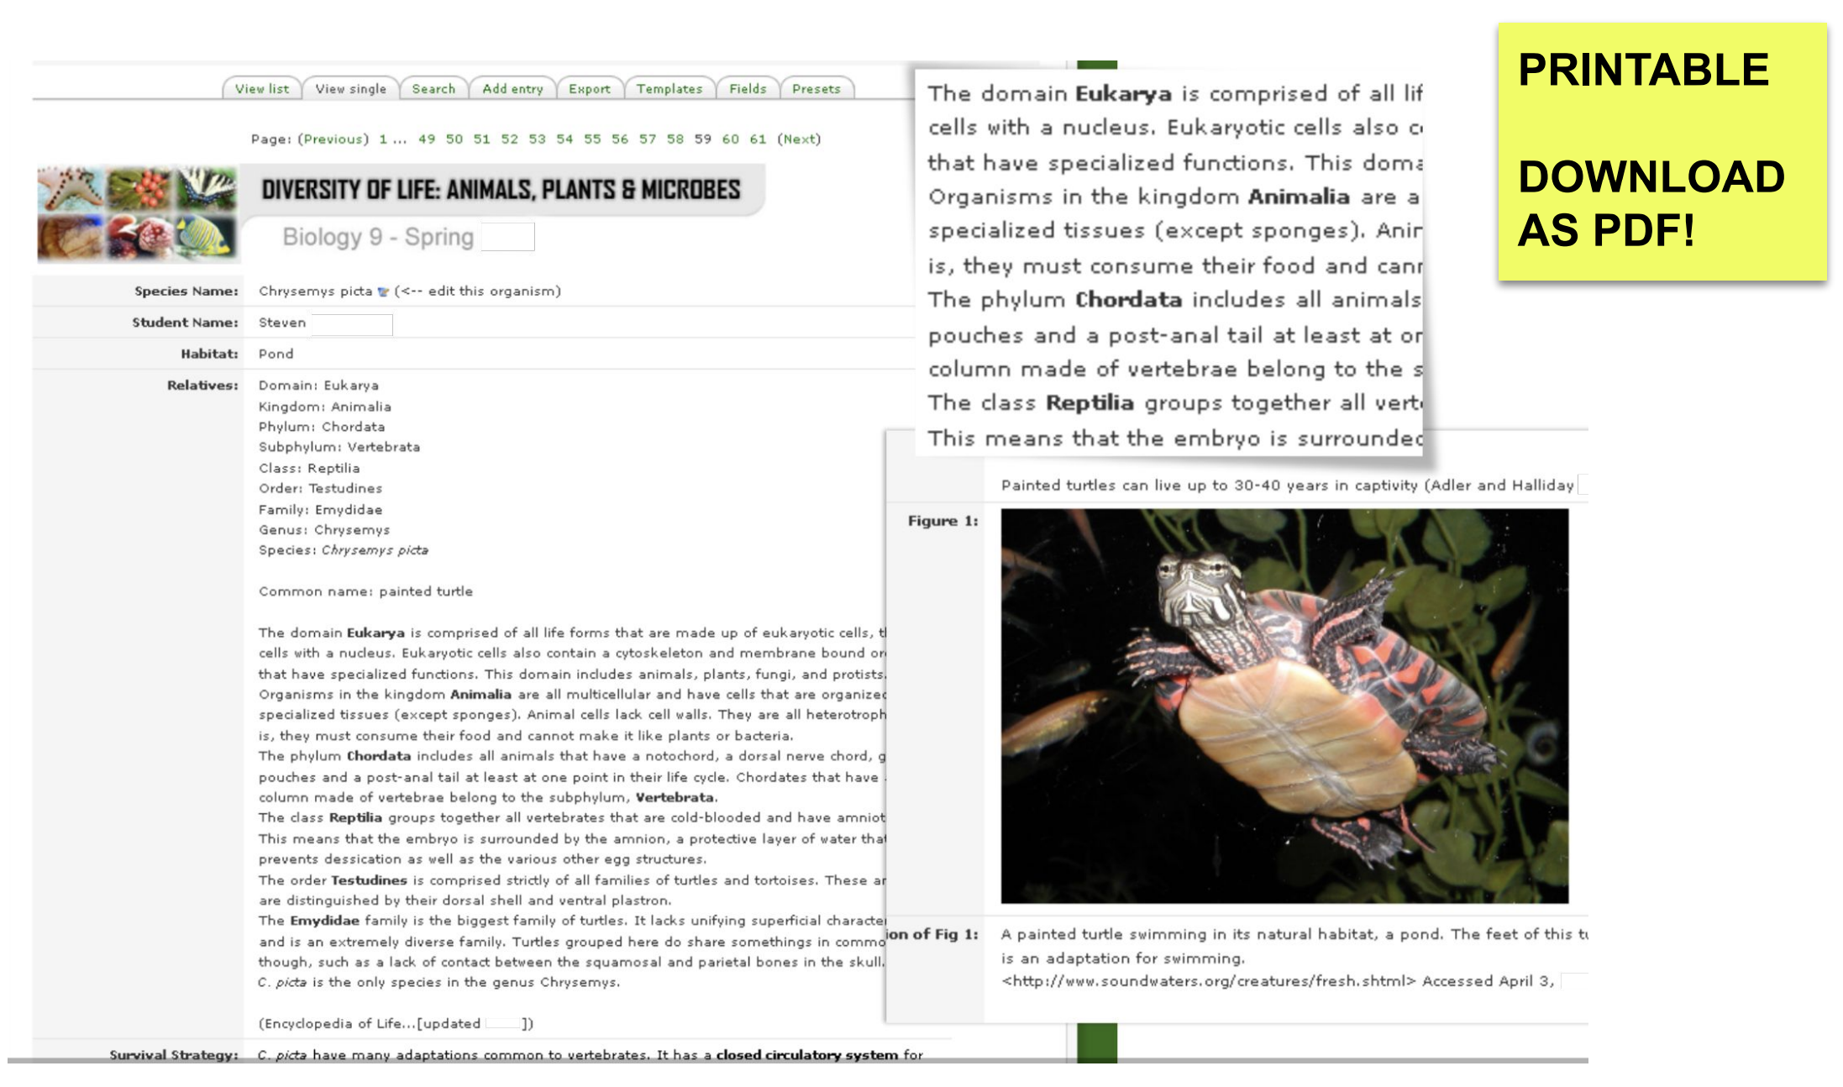
Viewing a Single Entry

Slide 8
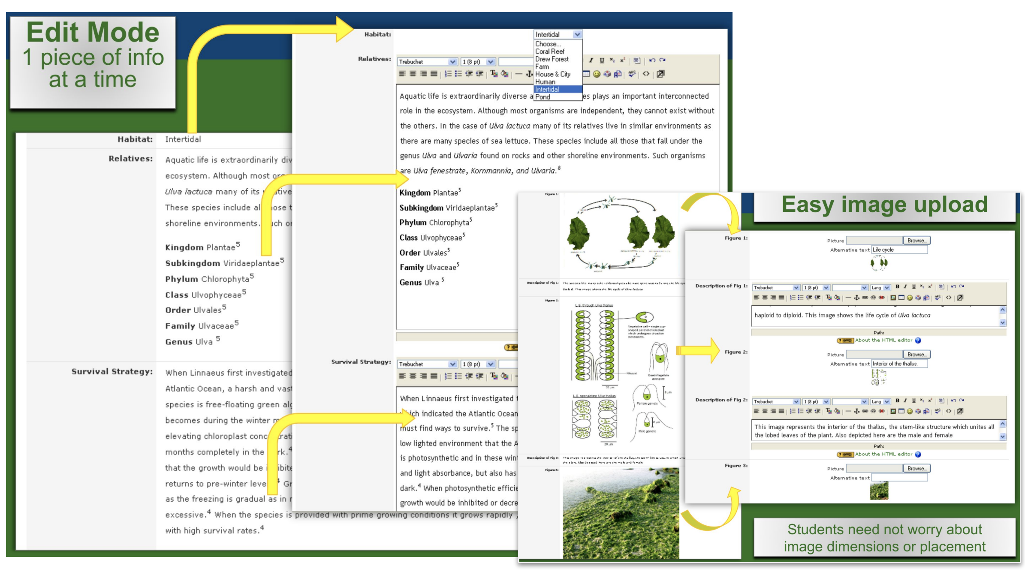
Adding/Editing an Entry

Slide 9
#2 Course Development Tracker
Problem: Which courses are close to completion so that Marketing can push program publicity?

Slide 10
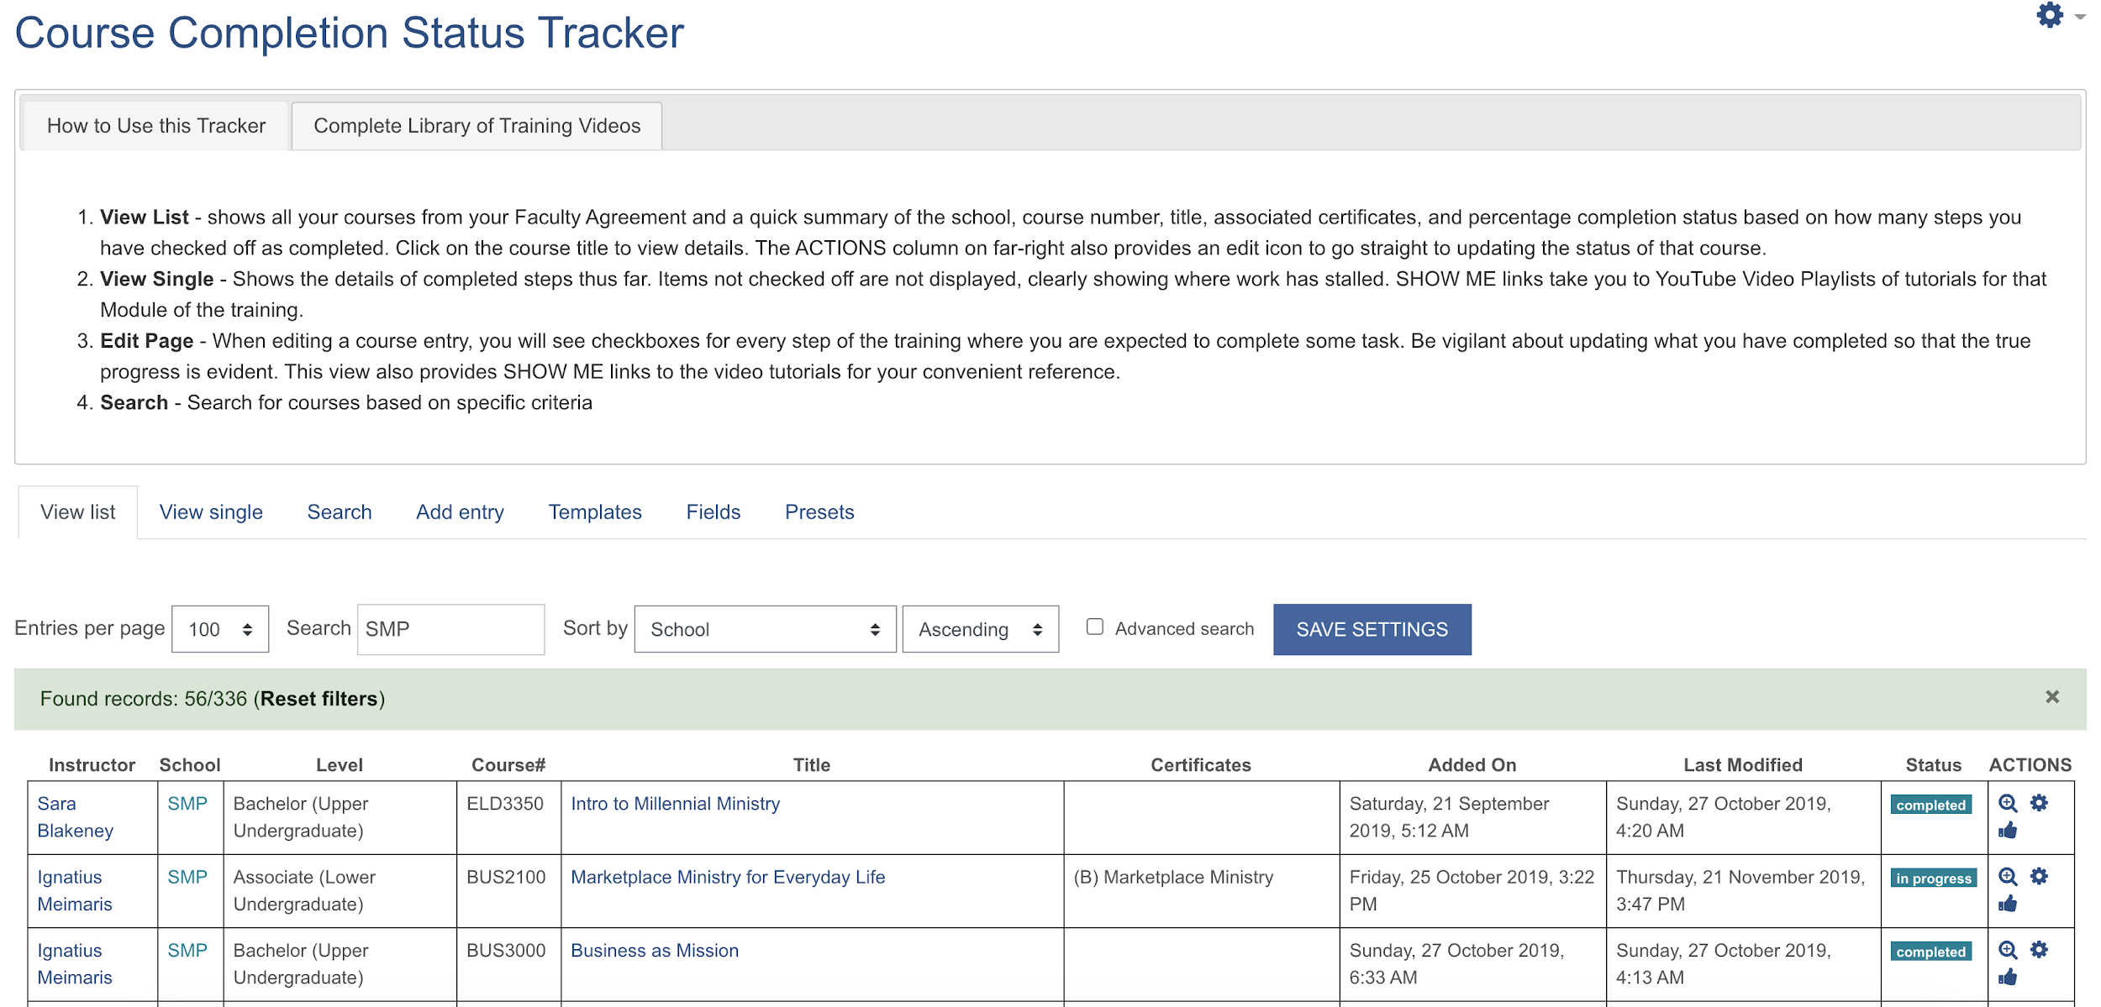
Training / Workflow / GTM Strategy

Slide 11
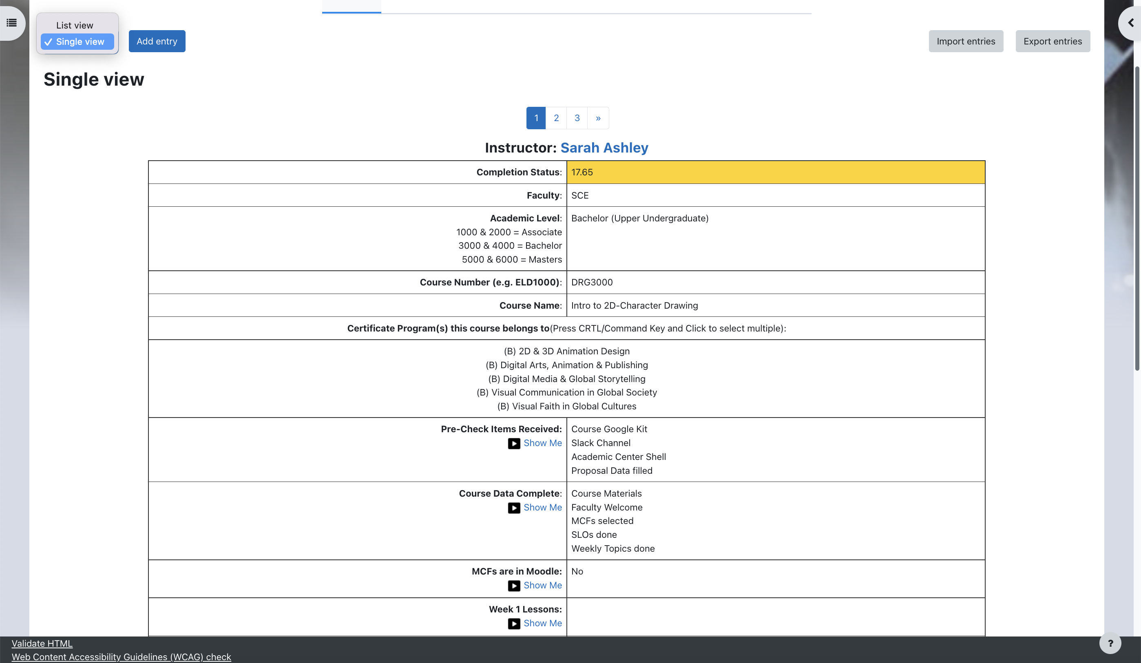
New view switcher
in Moodle 4.0

Slide 12
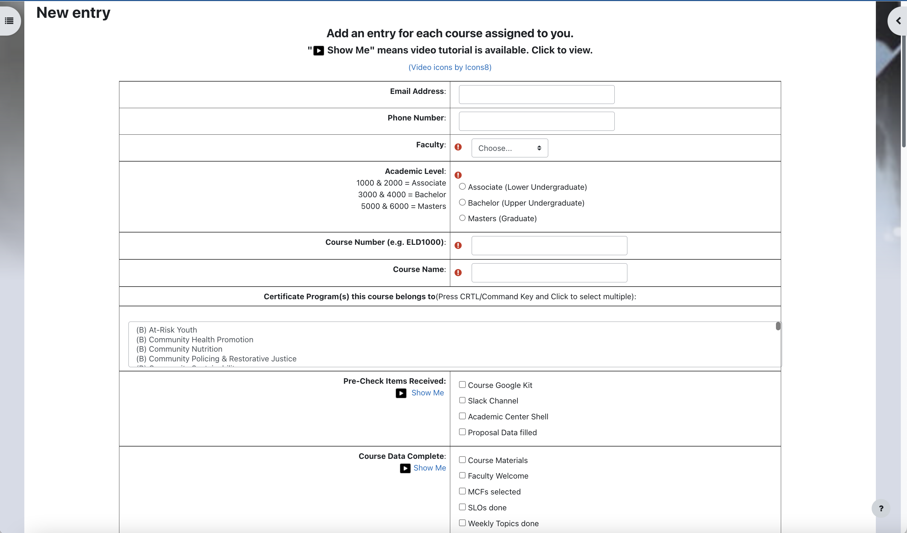
Adding/Editing a Course Entry
+ Dropdown menus
+ Radio buttons
+ Text boxes
+ Multi-select lists
+ Checkboxes
+ Links to Tutorials in the Training Guide or YouTube Playlist of associated video tutorials for that Step

Slide 13
#3 Post-First Discussion Board
Academic “pin the tail
on the donkey”
Problem: How to prevent students being influenced by class responses before they post

Slide 14
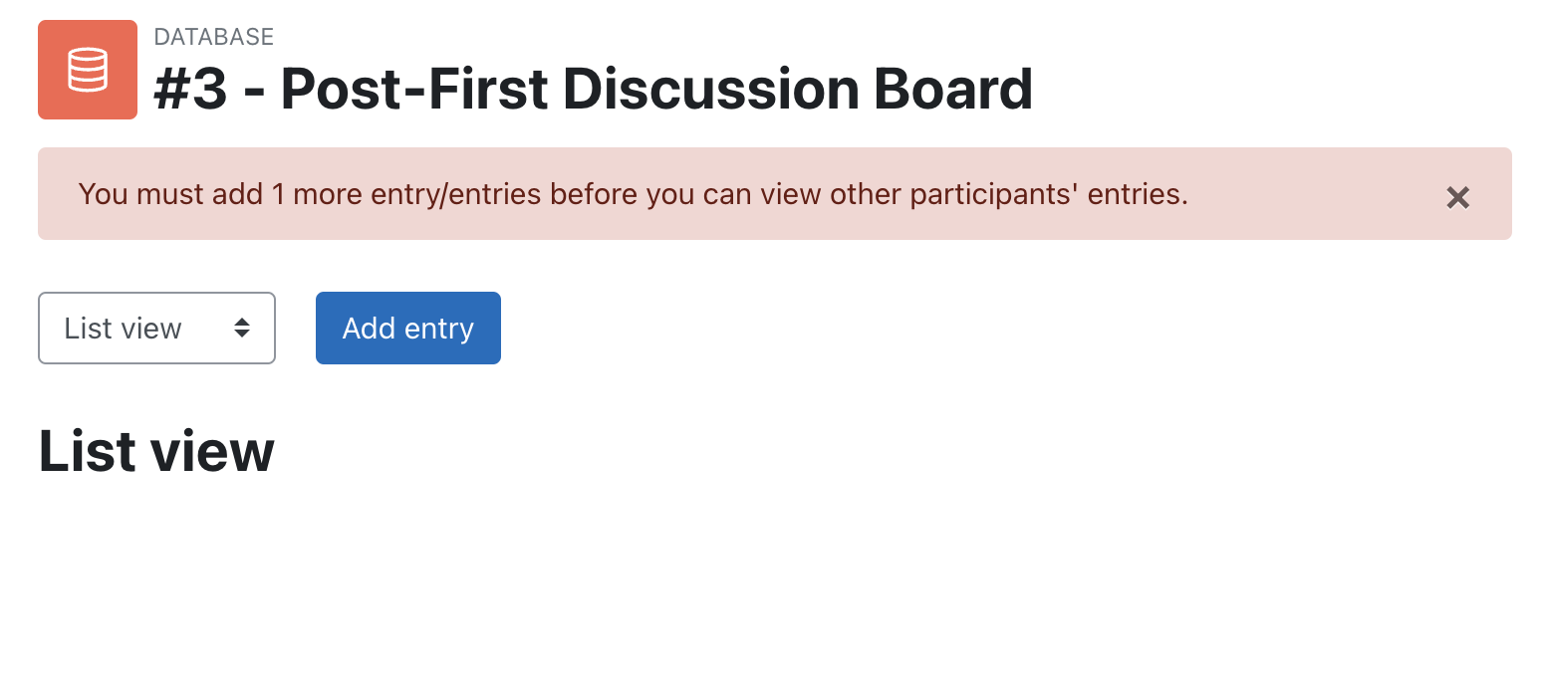
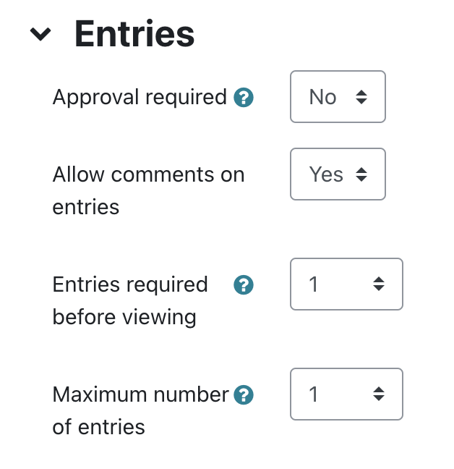
Key = ENTRIES in Settings

Slide 15
#4 Private Submission Dropbox
Problem: No easy way to see if a student had submitted all required documents for all Clinical Rotations

Slide 16
10 Assignments ⇒ 1 DB
Student uploads Journals
Separate groups
1 Student
1 Advisor
Advisor gives feedback
Private Submission System
In Database settings, enable RSS Feed per entry
Advisor subscribes for entry notifications

Slide 17
All Entries by one student

Slide 18
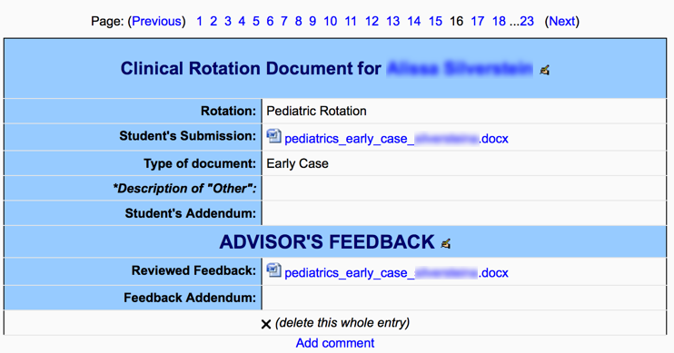
All aspects of a Single Entry

Slide 19
Adding/Editing an entry
Can include instructions for filling entry

Slide 20
#5 Community-Service Log
Problem: Students could not tell if they had met the Community Service hourly requirement for graduation

Slide 21
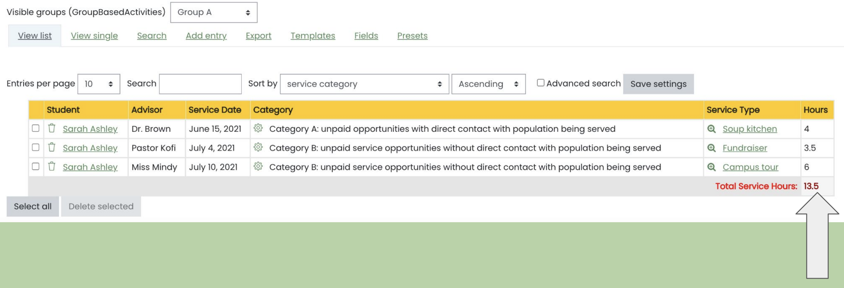
Academic / Individual / Teams
Adding up the hours in this column with javascript
on the List View template

Slide 22
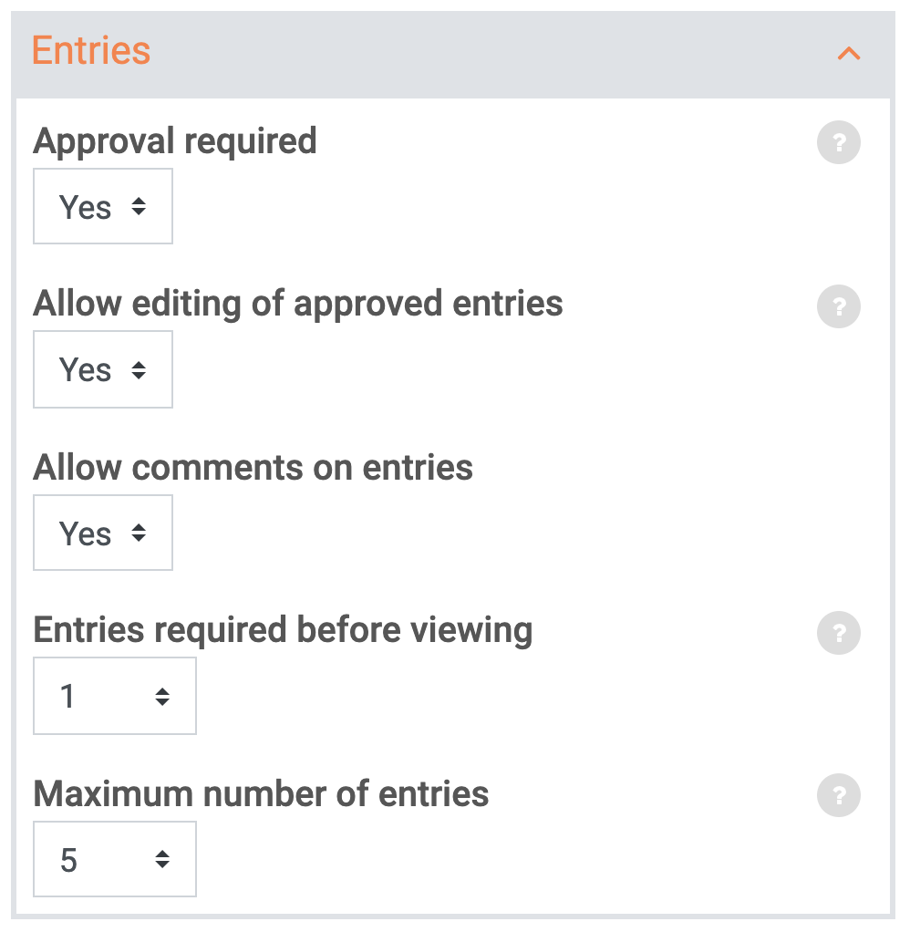
Creating a Database Activity
Add an activity or resource
Select “Database” ➔ enter Name
Add instructions to “Description”
Set up
Entries
Availability?
Ratings?
Restrict Access?
Activity Completion?
Competencies?
Create fields
Set up Templates
Add sample entries

Slide 23
How it all works: Settings
ADD ENTRIES
open/close date
VIEW ENTRIES
open/close/require #
ALLOW COMMENTS
encourage discussion
APPROVAL
what’s public?
RATINGS
grades/feedback
Notes:
Headline, image and dot points slide

Slide 24
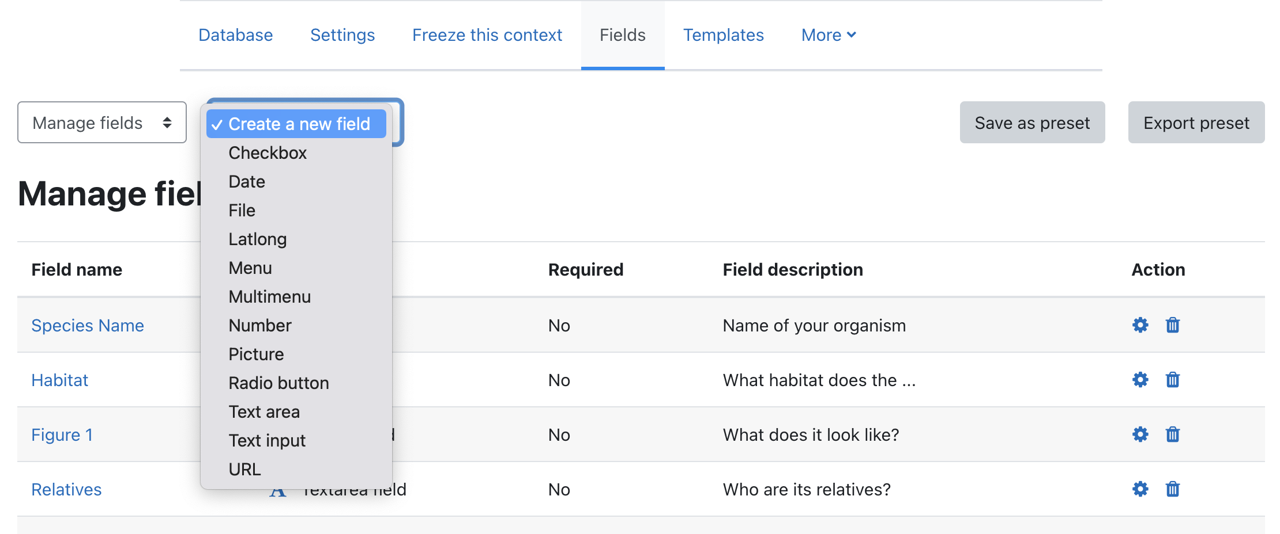
What information to collect? FIELDS

Slide 25
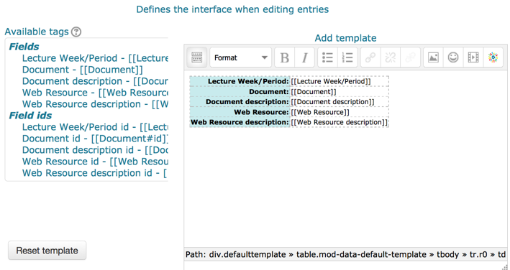
Templates: How should it look?
ADD/EDIT entry
SINGLE entry
LIST of entries
SEARCH for entries

Slide 26
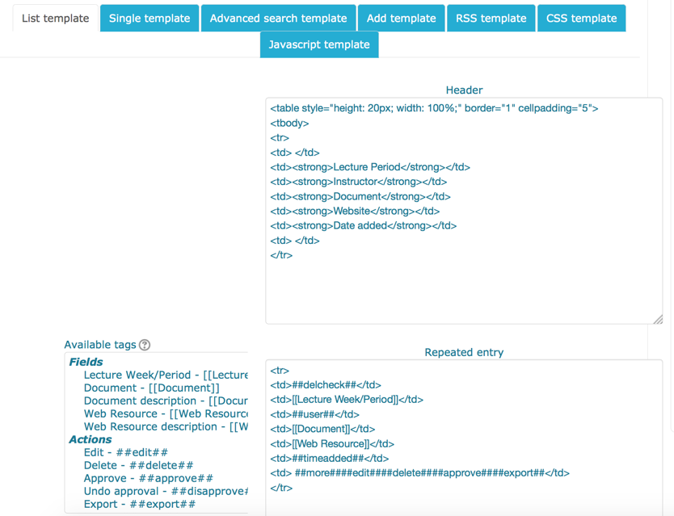
List View
Template
Recommended:
Disable the Editor and use HTML for better control
Header = column titles
Repeated entry = one row
Footer = last row

Slide 27
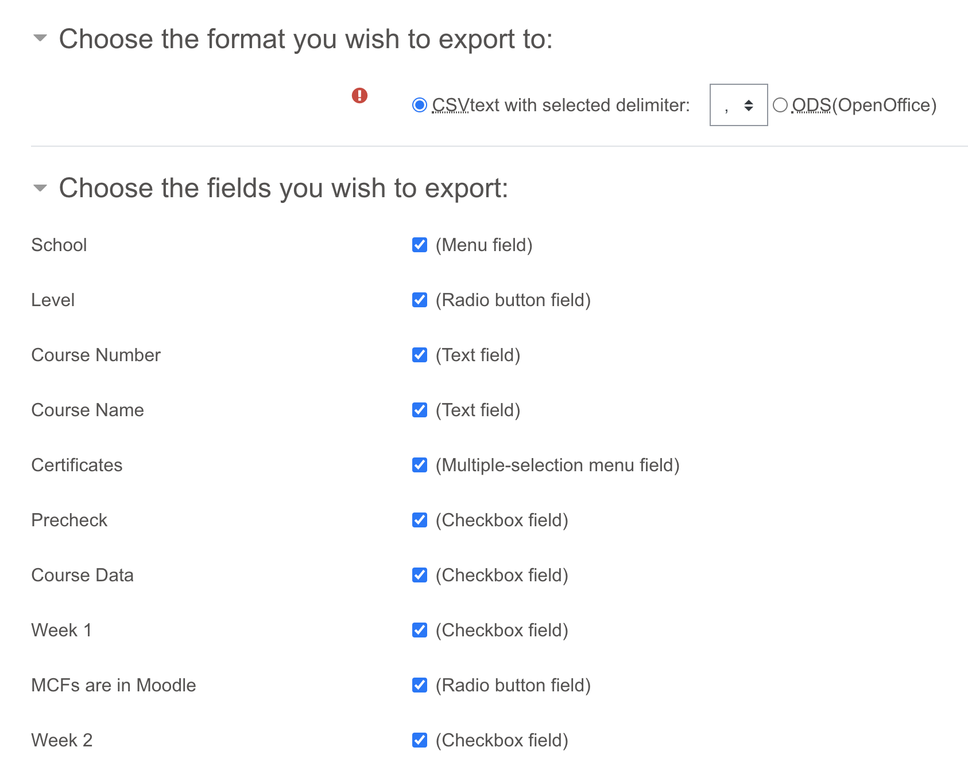
Archive the entries
portable
EXPORT includes
No images
No uploaded files
COURSE BACKUP will preserve all user data and files.

Slide 28
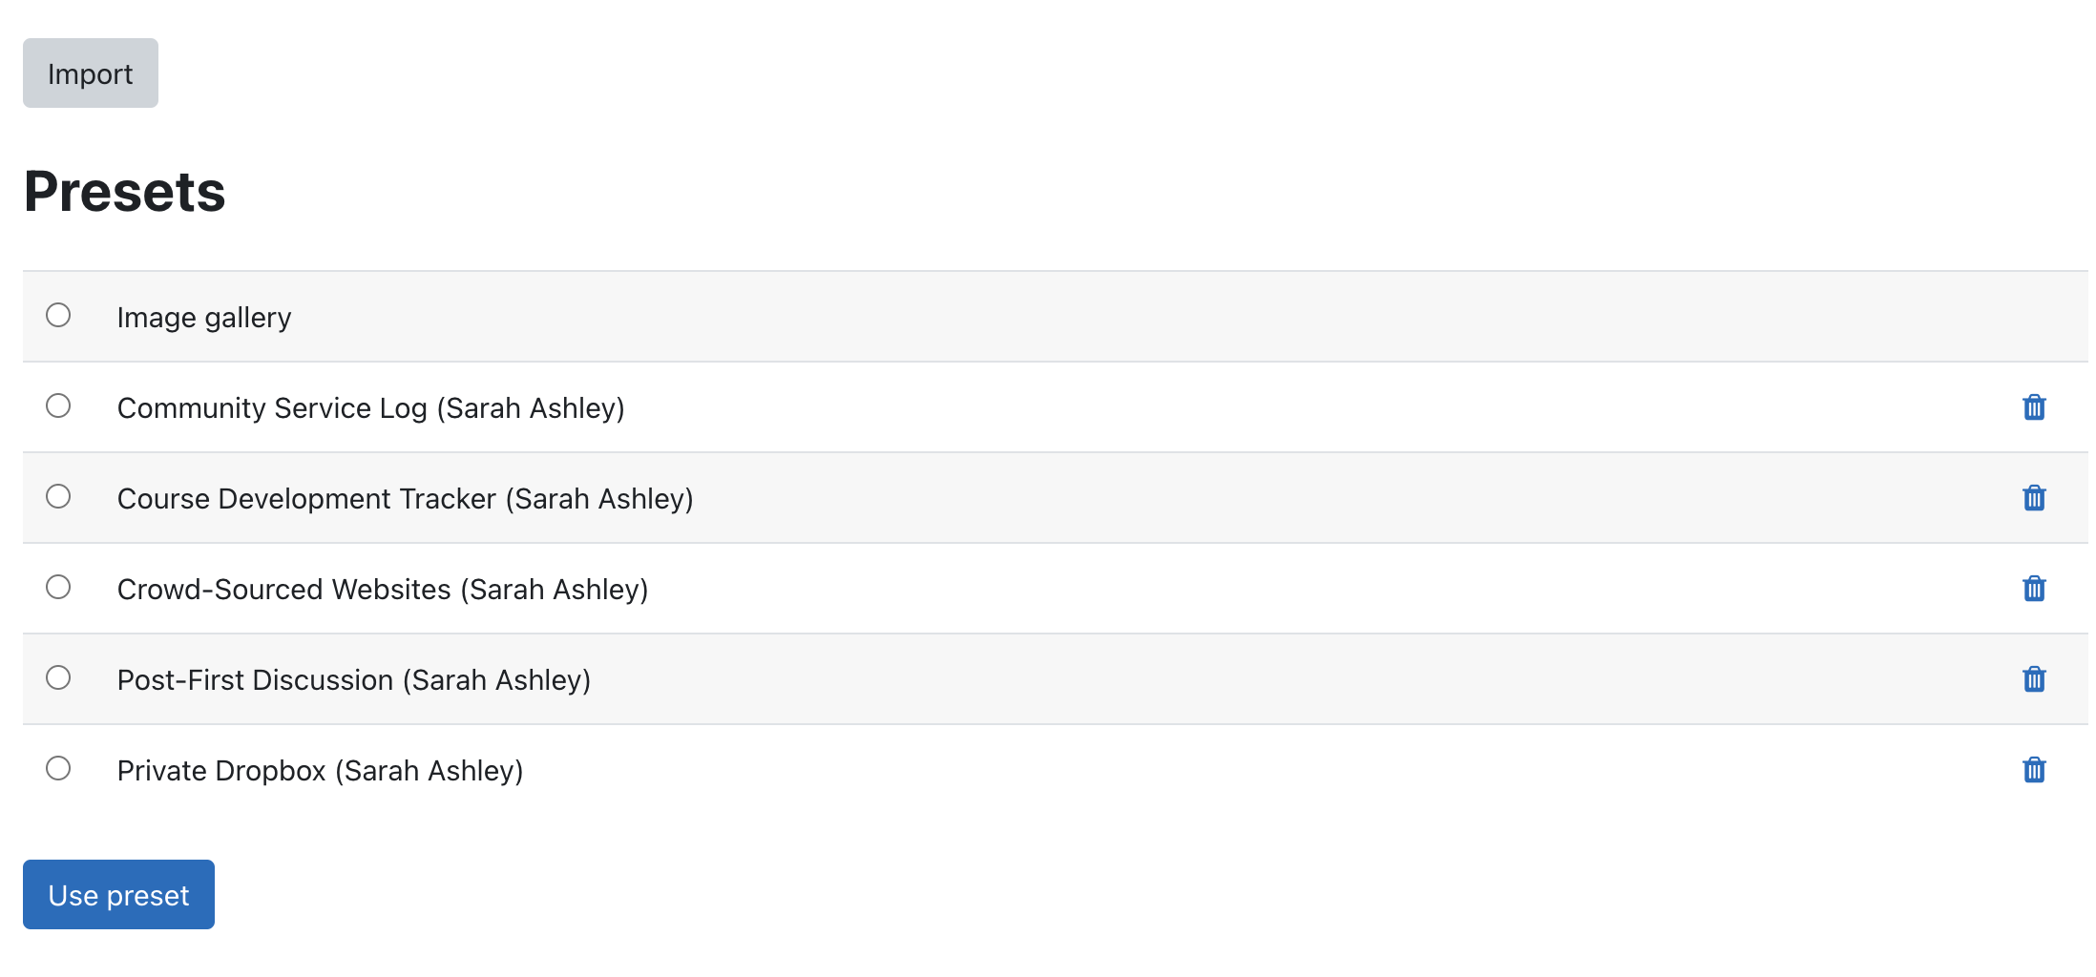
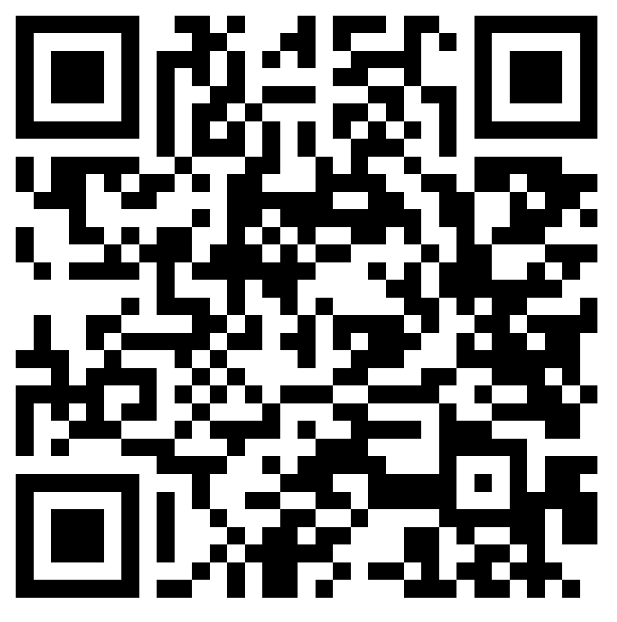
Package it for Reuse
portable
Fields ➔ Save as preset (reuse on same site) / Export preset (reuse on another site)
Goodies
for you!
TO REUSE:
More ➔ Presets
Import a zip OR
Select preset on the same site

Slide 29
Closing slide
Goodies
to play with
& download!
Sarah Ashley
sarah.ashley@moodle.com

