Slide 1
‘The Moodle that (always) goes wrong’: a tale of Moodle performance and accessibility failures
Aurelie Soulier and Nikola Bozhkov
27 September 2022 #MootGlobal22

Slide 4
Nikola and Aurelie
Nikola Bozhkov
Technical Lead, UCL.
12+ IT experience in UK Higher Education.
Moodle since 2020.
Aurelie “Oh really” Soulier​
Teaching and computing (PG qualifications) background.
15 years (+) in digital education (UK Higher Education and Moodle Partner).
Moodle since 2006.
UCL –> edtechhuman ltd & Moodle Community Engagement Lead.

Slide 5
Poorly-designed courses
Related course design issues
Related course performance issues
How to fix these
Well-design courses
Your design tips
Notes:
We’ve all hopefully seen beautiful examples of well-designed Moodle courses, and with many courses at UCL following our Connected Learning Baseline (UCL Connected Learning Baseline: template and exemplar course launched, 2020) and using the ABC toolkit (Designing programmes and modules with ABC curriculum design, 2018) we are lucky to witness good practice, regularly. No doubt, we have all also observed some terrible design errors?
In this presentation, we will tell the story of what happens when everything that can go wrong in a Moodle course...goes wrong!
It's all about the end-user – some aspects seem very 'back end' and technical but all impact the user experience

Slide 6
Here’s Prof Susan Ninby
Susan is a lecturer.
She has some issues with accessibility and performance in a Moodle course, should we help her?
all vector images in this presentation are from vector stock
Notes:
Let’s all say hello to Susan! She needs our help. She’s run her course on Moodle since 2012 but she’s having complaints from students about access and navigation and she’s phoned us because her course crashes regularly with some tasks, like when running quizzes, downloading grades to name a few.

Slide 7
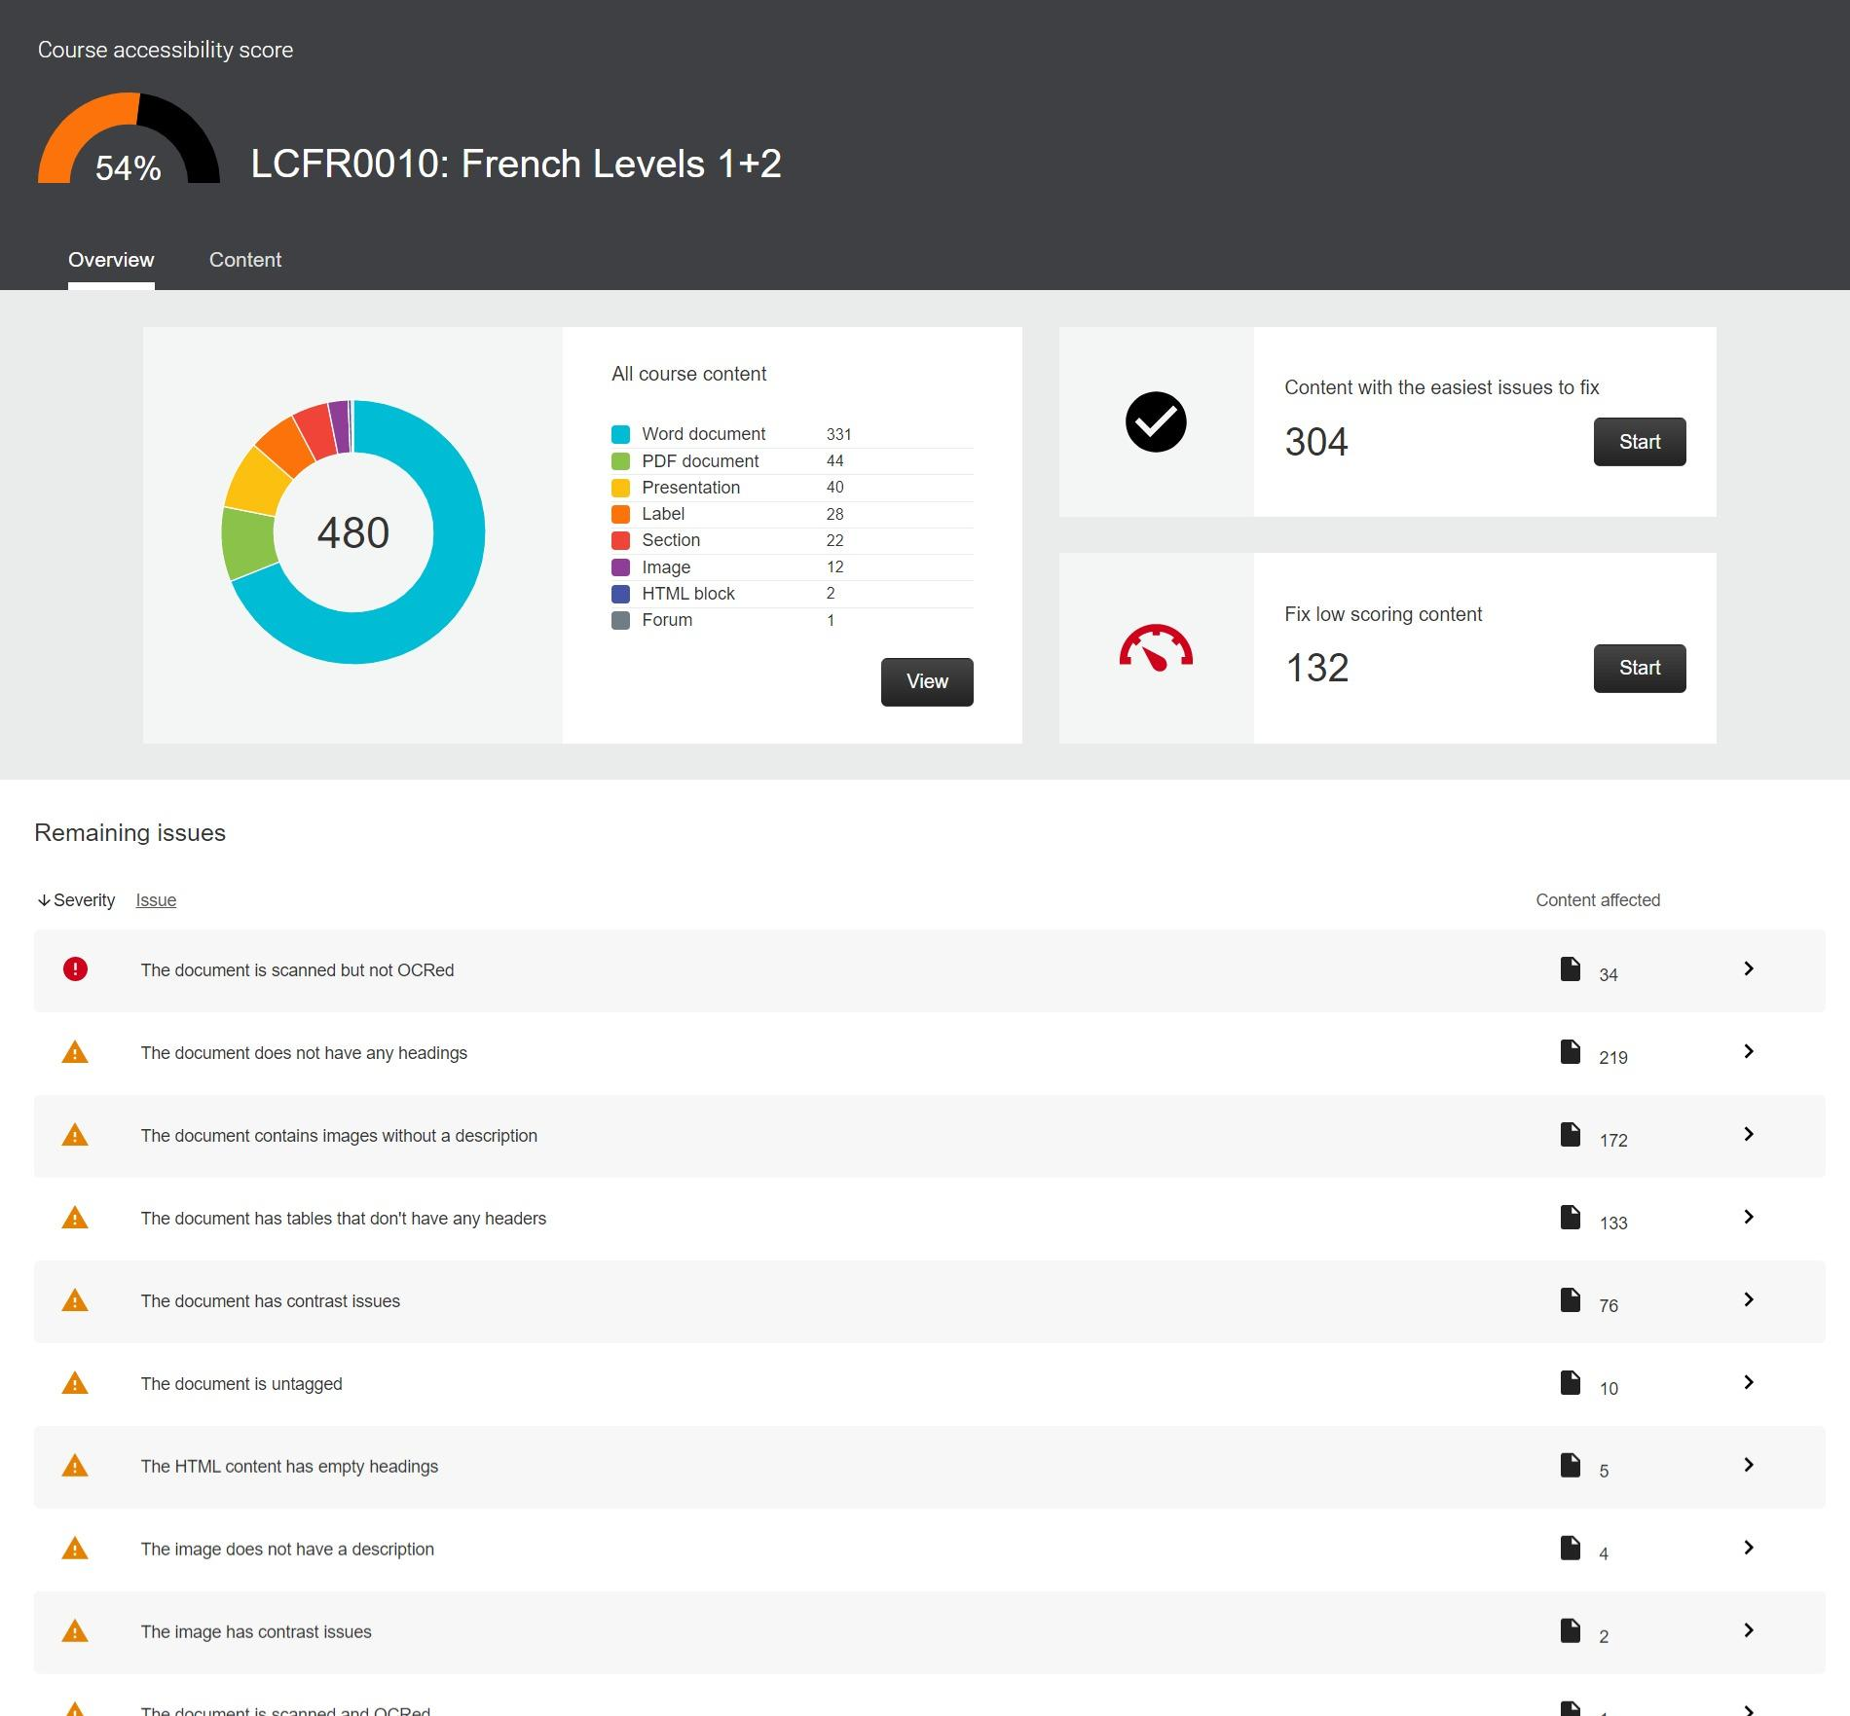
Design issues in Susan’s course
Accessibility issues.
Copied and pasted text/pictures / content included multiple colour headings manually formatted.
Decorative images and images with no alt text.
Videos on auto-play.
Text embed in images and PDF.
Notes:
It’s not looking good, Susan!

Slide 8
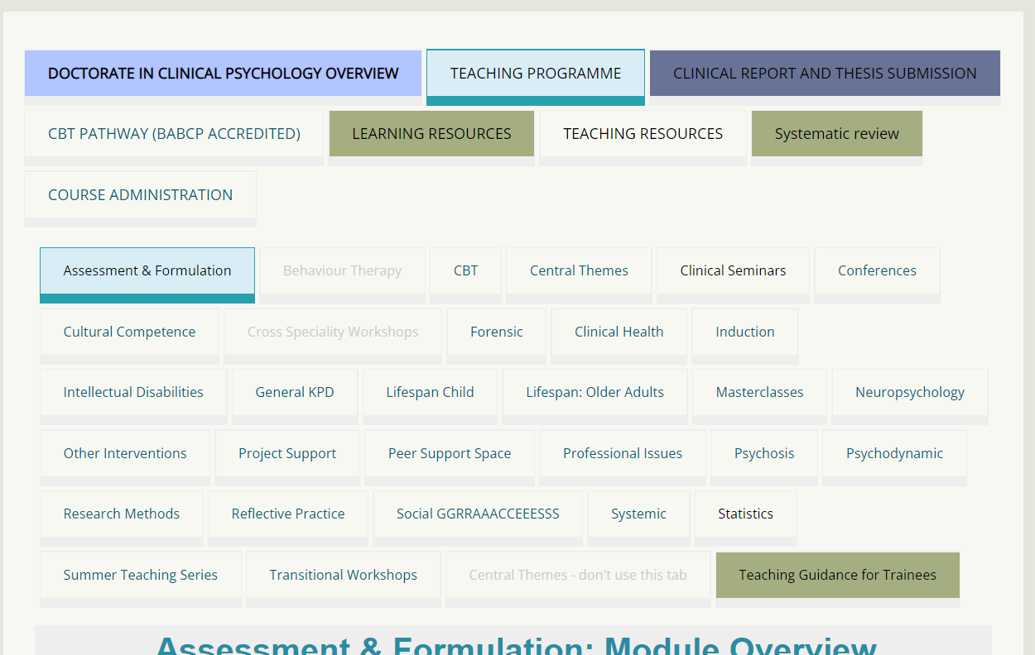
Design issues in her colleagues’ courses
Coloured tabs (without meaning / key for colour).
Tons of tabs and sub-tabs.
Notes:
Susan check her colleagues’ courses for advice… but Andrew’s courses are full of tabs and sub-tabs...and wonderful rainbow colours… so she can’t access these well through her screen reader.

Slide 9
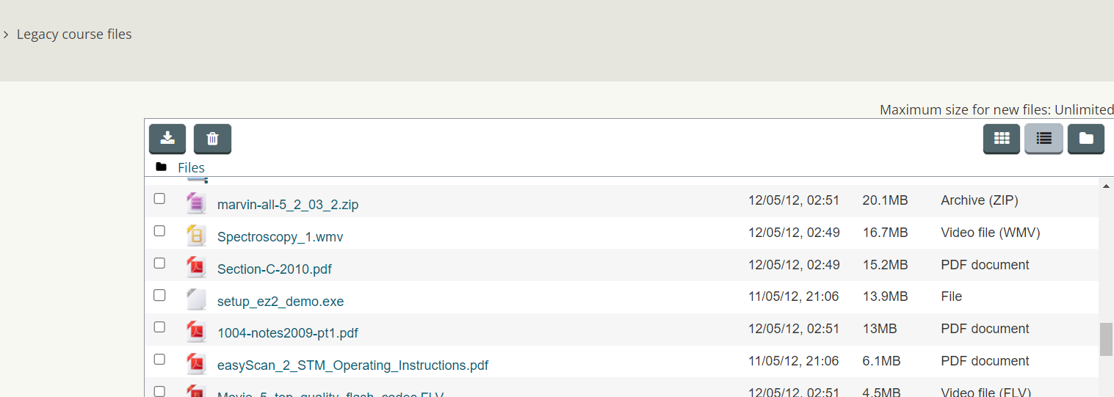
Performance issues in Susan’s courses
mbz backup file > 1GB.
Course backup timing.
Course restore failing.
Legacy Files (old / unused).
Notes:
Susan’s run this course since 2012 and has loads of legacy files… it makes her backup file massive!

Slide 10
Related course design issues
‘Timeless’ course (not refreshed every year) - carries the issues on.
Endless sections.
impossible to find content.
navigation issues.
Accessibility issues.
Using irrelevant pictures.
not accessible.
use storage.
Notes:
Here are a few other issues we’ve found when looking at Susan’s course… she’s not having a good day!

Slide 11
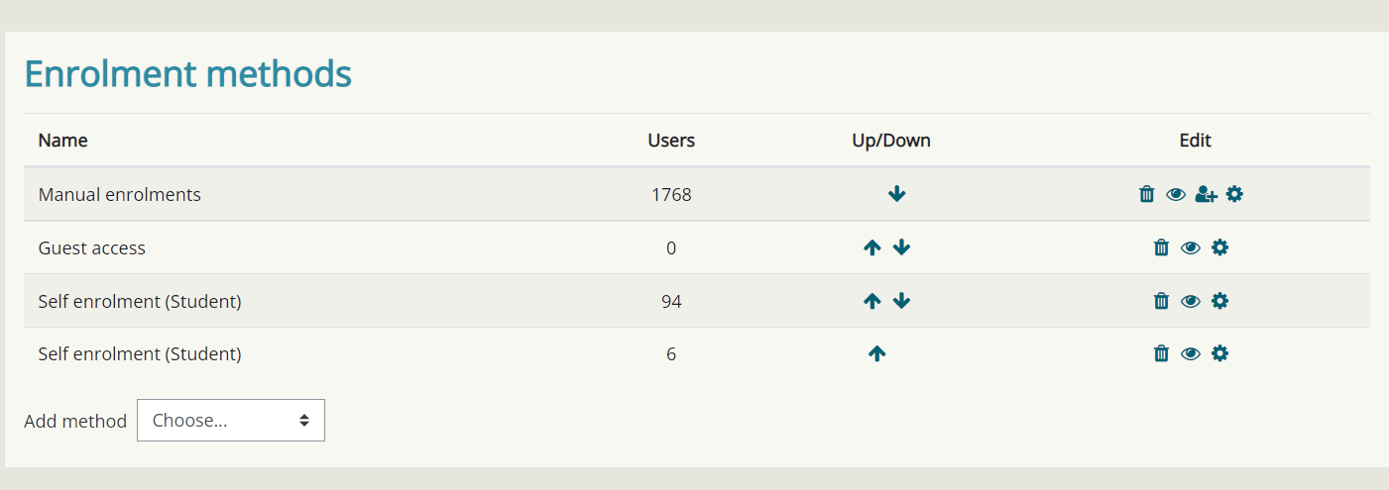
Related course performance issues
Voluminous manual enrolments (1000s of users).
Gradebook timeouts issues in export. (due to course manual enrolment sizes + maybe also Cloud config).
Quiz setup – thousands of learners all starting at once.
STACK questions poorly configured.
Variants are not fair.
quizzes crash when loading on-the-fly variants for hundreds of users.
Notes:
Nikola is trying to help resolving her course performance issues and found out these are a few causes of the slow course and occasional course crashing.

Slide 12
Notes:
So here’s what the team advised Susan to do….

Slide 13
Tips to improve design and performance for tutors / course administrators
Use automatic enrolments (based on Student Records System).
Check your course legacy files if you have a timeless/old course and remove them from legacy files/add to a repository.
Don't keep files/topics that aren't used (these should be in previous versions if you rollover periodically).
For large cohort, stagger quiz start time.
For STACK, deploy variants prior to the quiz run, not on-the-fly at the time of running the quiz this ensures you can check for fairness but also help performance.
Ask help from you Learning Technologists to improve design.
Notes:
So here’s the advice the Team came up with.

Slide 14
Tips to improve design and performance for site administrators
Work with you host / Cloud provider (Catalyst for us) to fine tune performance.
If you're behind DDOS protection service (e.g. Cloudflare) you can fine tune file upload size and timeouts to allow Moodle to function correctly .
Migrate from LDAP to AAD or SAML2 authentication to reduce load and reduce table locks.
Implement performance monitoring (CloudWatch, NewRelic, etc. ) & investigate reduced performance before your site goes down.
Notes:
Migrate from on-prem authentication and user provisioning to a cloud based and more secure one i.e LDAP (Active Directory) to Azure Active Directory or SAML2. Reduces server load and table locks (full sync vs deltas).
As presenter notes: UCL migrated from LDAP to Azure Active Directory. SAML2 is also strong candidate (difficult to integrate O365 Products like MS Teams Also…Al submitted to Moodle Core some improvements to LDAP integration to help reduce performance issues – so hopefully this benefits others

Slide 15
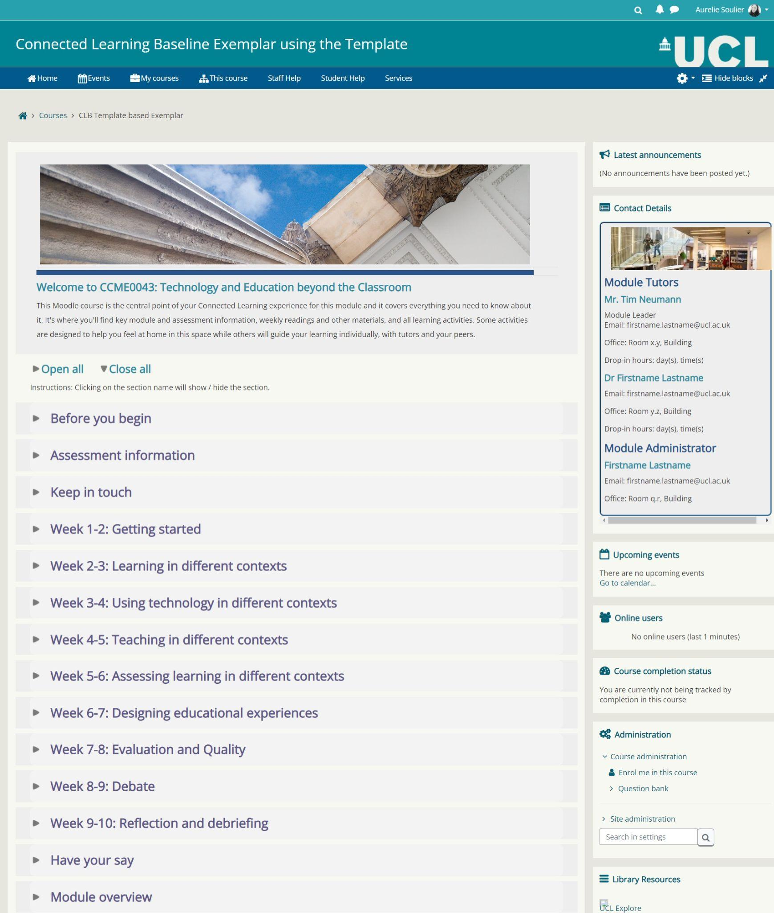
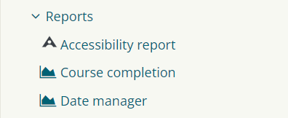
What do well-designed courses look like?
Connected Learning Baseline (UCL Connected Learning Baseline: template and exemplar course launched, 2020).
ABC toolkit (Designing programmes and modules with ABC curriculum design, 2018).
Automatic enrolments.
Updated periodically to remove obsolete content (e.g.: yearly rollover and activity dates updated) .
Accessibility checks.

Slide 16
What are your top tips?
https://www.menti.com/altj3c3inf5g
Go to www.menti.com and use the code 12 60 40 3
Notes:
https://www.mentimeter.com/app/presentation/4cf836b79713a788b40dabd87a62005b

Slide 17
Thank you and questions

Slide 18
References
Teaching & Learning. 2020. UCL Connected Learning Baseline: template and exemplar course launched. [online] Available at: <https://www.ucl.ac.uk/teaching-learning/news/2020/may/ucl-connected-learning-baseline-template-and-exemplar-course-launched> [Accessed 16 September 2022].
Teaching & Learning. 2018. Designing programmes and modules with ABC curriculum design. [online] Available at: <https://www.ucl.ac.uk/teaching-learning/case-studies/2018/jun/designing-programmes-and-modules-abc-curriculum-design> [Accessed 16 September 2022].

